Slide 1

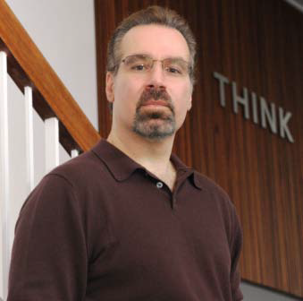
CISE DISTINGUISHED LECTURE SERIES
Tuesday, March 6 at 2pm, Room 110
Building Watson: An Overview of the DeepQA Project
Dr. David A. Ferrucci, IBM
Computer systems that can directly and accurately answer peoples' questions over a broad domain of human knowledge have been envisioned by scientists and writers since the advent of computers themselves. The DeepQA project is aimed at exploring how advancing and integrating Natural Language Processing , Information Retrieval, Machine Learning, Knowledge Representation and Reasoning, and massively parallel computation can greatly advance the science and application of automatic Question Answering.
An exciting proof-point in this challenge was developing a computer system that could successfully compete against top human players at the Jeopardy! quiz show (www.jeopardy.com). An important contributor to Watson’s success is its ability to automatically learn and combine accurate confidences across a wide array of algorithms and over different dimensions of evidence. High precision and accurate confidence computations are critical for real business settings where helping users focus on the right content sooner and with greater confidence can make all the difference. In this talk, I will introduce the audience to the Jeopardy! Challenge, explain how Watson was built on DeepQA to ultimately defeat the two most celebrated human Jeopardy Champions of all time and I will discuss applications of the Watson technology beyond in areas such as healthcare.
Dr. David Ferrucci is an IBM Fellow and the Principal Investigator (PI) for the Watson/Jeopardy! project. He has been at IBM’s T.J. Watson’s Research Center since 1995 where he heads up the Semantic Analysis and Integration department. Dr. Ferrucci focuses on technologies for automatically discovering valuable knowledge in natural language content and using it to enable better decision making.
Talks held at 4201 Wilson Blvd. Questions: Contact Amanda Shea at ashea@nsf.gov

