Slide 1
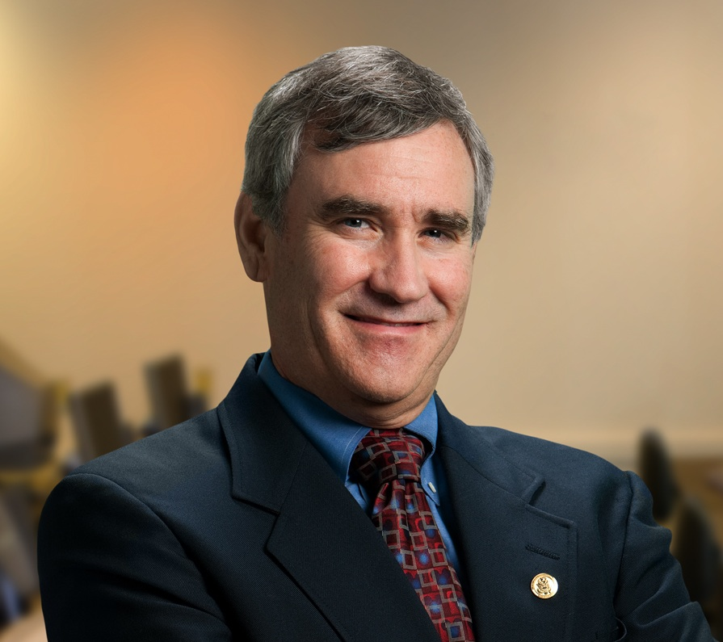
W ashington A rea T rustworthy C omputing H our
10th WATCH:
Barriers to the Science of Security
Tom Longstaff
National Security Agency
John Hopkins University
THURSDAY March 15, Noon, Room 110
About the WATCH series:
Transforming today’s trusted but untrustworthy cyberinfrastructure into one that can meet society’s growing demands requires both technical advances and improved understanding of how people and organizations of many backgrounds perceive, decide to adopt, and actually use technology. WATCH aims to provide thought-provoking talks by innovative thinkers with ideas that illuminate these challenges and provide signposts toward solutions. The series is jointly organized by NSF’s Computer Science and Engineering (CISE) and Social, Behavioral, and Economic (SBE) Directorates and the Office of Cyberinfrastructure (OCI), and sponsored by the CISE Trustworthy Computing Program. Talks will be recorded and made available over the Internet.
In the past few years, there has been significant interest in promoting the idea of applying scientific principles to information security. The main point made by information security professionals who brief at workshops and conferences seems to be that our field of information security is finally mature enough to begin making significant strides towards applying the scientific approach. Reports such as the Jason’s report on the Science of Security point to examples and approaches we should take to achieve success in applying science to security. Audiences everywhere enthusiastically agree and thrash themselves for bypassing science all along, bemoaning the fact that we could be "so much further along" if we only did science. Of course, after the presentation is over, everyone goes back to the methods that have been used throughout our generation to create prototypes and tools with no regard for the scientific principles involved. Why? In this presentation, I explore the barriers to adopting a scientific approach to experimental information security projects, including:
time to publish as a primary driver
standard of peer reviews in conferences and journals
expectation of a breakthrough in every publication Based on overcoming these issues, I will explore a more practical way by focusing on changes in attitudes and processes necessary for science of security to become more the rule than the exception.
Speaker
Dr. Tom Longstaff is currently on a two-year assignment as the Technical Director of the Systems Behavior group within the DoD National Security Agency. Prior to coming to NSA in 2012, Tom was the Chief Scientist for the Cyber Missions Branch of the Applied Physics Laboratory (APL). Tom is also the chair of the Computer Science, Information Assurance, and Information Systems Engineering Programs within the Whiting School at The Johns Hopkins University.
Thursday, March 15, 2012
continuing April 19 with Lorie Cranor
NSF Stafford I Room 110, Noon
Public Invited
Questions/comments about WATCH? Contact Keith Marzullo kmarzull@nsf.gov
Website: http://www.nsf.gov/cise/cns/watch/
(or google “NSF WATCH”)

