Slide 1
BIO AC Data Working Group (Apr-Aug 2012)
Jonas S Almeida (chair), Brett Tyler (co-chair), Carol Brewer, Hopi Hoekstra, Gaetano Montelione, Jose Onuchic. Executive Secretary: Melissa Cragin.

Slide 2
BIO AC Data Working Group (Apr-Aug 2012)
Jonas S Almeida (chair), Brett Tyler (co-chair), Carol Brewer, Hopi Hoekstra, Gaetano Montelione, Jose Onuchic. Executive Secretary: Melissa Cragin.
Executive Summary
The data workgroup was charged with studying and discussing Data Science in the context of NSF’s BIO initiatives. This is an area driven by extremely fast advances in Web Technologies such as Semantic Web and Cloud computing that have the potential to empower individual life science researchers with resources not available even to large organization just a few years ago. In contrast, the articulation of those resources with the wide availability of commodity/social computing infrastructure for data sharing and team science is much less widely understood and rarely informs policy making or calls for proposals in BIO. This tension is compounded by life sciences-specific issues, such as the variable granularity of data at different scales and uneven visibility/accessibility of data generated by BIO initiatives in the past. A number of recommendations are made with a focus on a) closer involvement of the research communities that generate and consume the data and b) opportunities to experiment with the novel computational infrastructures to handle real world biological data.

Slide 3
BIO AC Data Working Group (Apr-Aug 2012)
Jonas S Almeida (chair), Brett Tyler (co-chair), Carol Brewer, Hopi Hoekstra, Gaetano Montelione, Jose Onuchic. Executive Secretary: Melissa Cragin.
Sharing: interoperable linked data.
A large potential value exists for wide-scale sharing of biological data in an interoperable format. Sharing enables large-scale secondary analysis of the data that can reveal emergent features of the underlying systems. It also enables a more innovative and transformative analysis of primary data, and invites an unprecedented level of participation in the scientific enterprise. This is a level of integration, and engagement, that scientific communities, and the public at large, have come to expect as a basic feature of an era where social computing infrastructure is a commodity resource. Standards for describing and annotating data and associated metadata are essential for capturing the biological implications in an interoperable format, but such standards are still widely unavailable or inadequate for a wide diversity of data types, including proteomics data, metabolomics data, phenotypic data, mass spectrometry data, biological image data, NMR-related data, ecological data, behavioral data.
Recommendation: Individual communities should be funded to define priorities and procedures for sustainable data archiving and sharing, and for establishing community-specific data standards that are required to make their data widely biologically interoperable as well as technically interoperable.
Committee on a New Biology for the 21st Century, National Research Council of The National Academies (2009) “A New Biology For The 21st Century” National Academies Press, Washington, D.C.
Sansone, S.-A., Rocca-Serra, P., Field, D., Maguire, E., Taylor, C., Hofmann, O., Fang, H., et al. (2012). Toward interoperable bioscience data. Nature genetics, 44(2), 121–6. See also map at http://bit.ly/webofdata. .
[ enabling BigData ]

Slide 4
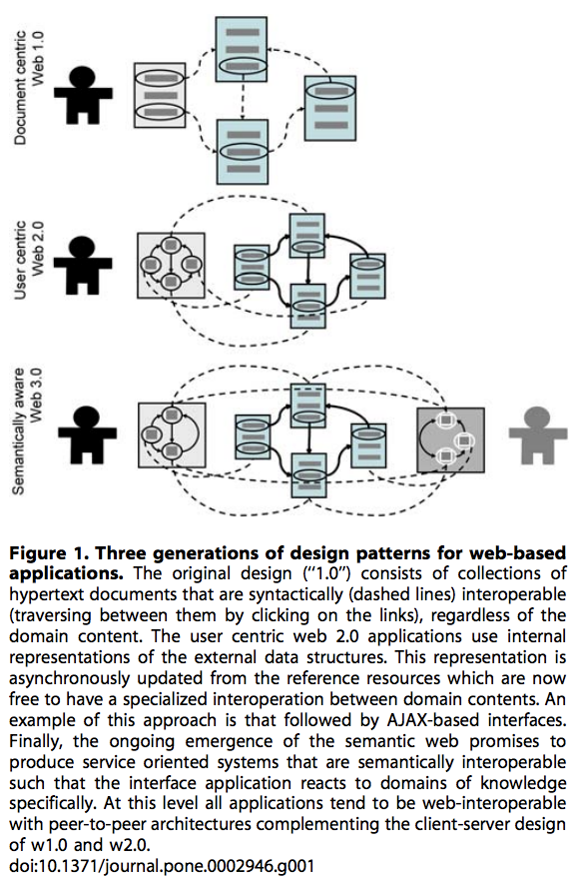
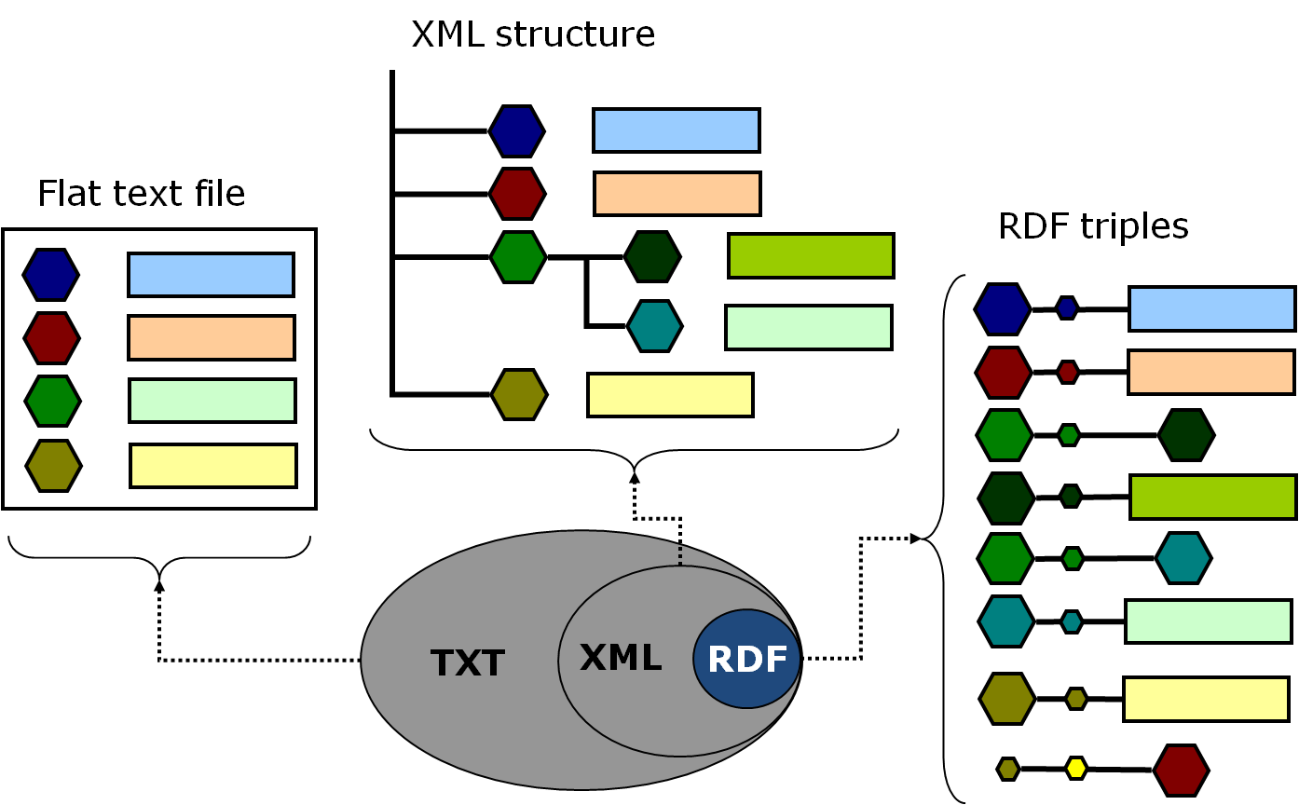
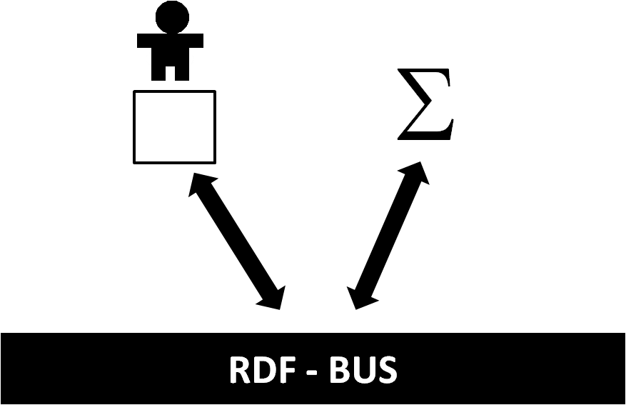

Slide 5
Infrastructure: integrative Web 3.0.
The combination of improved logistics of cloud computing and comprehensive linking enabled by the semantic web’s Resource Description Framework (RDF) provide a distributed infrastructure for wide-scale data sharing and distributed analysis. This has the potential to efface the logical barriers between large centralized infrastructures and specialized “beyond the data deluge” repositories tailored for data acquisition. It also could decouple infrastructure configuration from the inevitable, and desirable, antagonism between data generation and its annotation by further analysis, while enabling traceable provenance and reproducibility. One barrier to realizing the potential of RDF is lack of familiarity with RDF among biology communities and resources for converting legacy data into RDF formats. Another is that cloud computing platforms are still maturing as a flexible, cost-effective interoperable means for storing, moving, sharing and analyzing data.
Recommendation: Resources should be provided to improve communication between information scientists and biology communities, and identify cost-effective, easy-to-use cloud solutions, by funding demonstration projects. These should explicitly encourage public-private partnerships that address long term solutions for archiving public biological data.
BIO AC Data Working Group (Apr-Aug 2012)
Jonas S Almeida (chair), Brett Tyler (co-chair), Carol Brewer, Hopi Hoekstra, Gaetano Montelione, Jose Onuchic. Executive Secretary: Melissa Cragin.
Bell, G., Hey, T., & Szalay, A. (2009). Computer science. Beyond the data deluge. Science (New York, N.Y.), 323(5919), 1297–8. doi:10.1126/science.1170411
Peng, R. D. (2011). Reproducible research in computational science. Science (New York, N.Y.), 334(6060), 1226–7.
Berners-Lee, T., Hendler, J. (2010). From the Semantic Web to social machines: A research challenge for AI on the World Wide Web. Artificial Intelligence, 174(2), 156–161.
Halevy, A., Norvig, P., & Pereira, F. (2009). The Unreasonable Effectiveness of Data. IEEE Intelligent Systems, 24(2), 8–12.

Slide 6
Broader Impacts: the rise of the social machines.
Data produced by BIO funded initiatives have an uneven record of availability for subsequent use (secondary analysis, which includes the contextualization of primary analysis). Hopeful examples include iPlant, recognized as an innovator in data science, but in contrast with enduring concerns with LTER data. The onset of NEON last year created an urgent need and a also fantastic opportunity to make the most of data intensive approaches to such complex biological systems. The potential scientific, societal and economic impact of initiatives like NEON cannot be overstated and are critically associated with the long term availability and discoverability of the data generated. This is also a challenge that points to education as the ultimate interface for the achievements of BigData science: reaching beyond traditional Academic environments all the way to K-12 and citizen science through participatory (gamified?) initiatives. Education and outreach are areas where NSF BIO is particularly effective and respected. As a consequence, there are ample opportunities, resources and expertise to amplify the impact of societal intervention of this nature.
Recommendation: Consider adding data driven components to existing outreach and education programs - a particular strength of NSF BIO.
BIO AC Data Working Group (Apr-Aug 2012)
Jonas S Almeida (chair), Brett Tyler (co-chair), Carol Brewer, Hopi Hoekstra, Gaetano Montelione, Jose Onuchic. Executive Secretary: Melissa Cragin.

Slide 7
BIO AC Data Working Group (Apr-Aug 2012)
Jonas S Almeida (chair), Brett Tyler (co-chair), Carol Brewer, Hopi Hoekstra, Gaetano Montelione, Jose Onuchic. Executive Secretary: Melissa Cragin.
Funding models: promises and prizes.
It is reasonable to expect that scientific creativity will remain associated with diverse teams of researchers with reliable access to the necessary resources. The sustainability of data resources beyond a project’s funding period is therefore a growing concern.
Recommendation: Extend ongoing experimentation with funding models to the data generation components.
Heinze, T., Shapira, P., Rogers, J. D., & Senker, J. M. (2009). Organizational and institutional influences on creativity in scientific research. Research Policy, 38(4), 610–623.
Discussion notes:
Caution is advised: recall CaBIG and the failure of top-down ontologies, fixed stack grids etc… Recall happy endings too, for example TCGA.
There is no Web of Biology or Web of Chemistry, “one man’s garbage is another man’s gold”.
Social computing is emerging, and it may become the middle-layer for the Web 3.0 + Cloud (4.0* ?).
The gentlemen from Oregon ☺ will expand on “Sharing and Data Mining of Data via the Semantic Web”.
* when "technology and human become one”

Slide 8
Sharing and Mining of Data via the Semantic Web
Web
Services
Semantic Web
User Communities
Biologists
Information Scientists
Dispersed tools and services
Diverse Data Repositories

Slide 9
Multiple challenges must be addressed in parallel
Which data should be archived and shared?
Standards for describing and annotating data and associated metadata e.g. MIAME
How to get data into RDF format?
Where should data be hosted and how funded?
How to realize the value of shared data?

Slide 10
Which data should be archived and shared?
Which data types?
  nucleic acid sequences
  proteomics data
  metabolomics data
  phenotypic data
  mass spectrometry data
  biological image data
  NMR-related data
  ecological data
  behavioral data
  etc etc etc
What data sets?
  all raw data or subsets?
    how long?
  processed data?
    what processes?
  what metadata required?
  which legacy data?
  what data are obsolete?
Community decisions needed
$$

Slide 11
Standards for describing and annotating data and associated metadata
Some very basic issues: examples from genomics
  gene nomenclature
  reconciliation of different gene models
  reconciling different quality genome assemblies
Issues from functional genomics & mass spectrometry
  metadata standards e.g. MIAME
  reconciliation of different experimental protocols
Ontologies are good!
  need much more investment
  still need mechanisms to capture uncertainties
  much better connections needed to the literature
$$
Community decisions needed

Slide 12
How to get data into RDF format? or its successor(s)
Legacy data (long tail)
Accelerating accumulation of new data
Translating data into RDF is very labor-intensive
Most experimental biologists are unfamiliar with RDF
Need training and tools
  collaboration with information scientists
  need much deeper community involvement
  need novel approaches - gamification?
$$
Resources needed

Slide 13
Where should data be hosted and how funded?
The cloud has much potential but major obstacles remain
  heterogeneous public and private platforms
  narrow data pipes
    real time movement of large data sets infeasible
  usage restrictions on public platforms
  prohibitive business models on private platforms
  stifling security policies and APIs
Funding models for data repositories
  long-standing and rapidly escalting problem
  cloud or non-cloud: same problem
Need creative approaches
  demonstration projects
  public-private partnerships
Resources needed
$$

Slide 14
How to realize the value of shared data?
Value to the biological communities that generated the data
Emergent value realized through mining highly diverse interoperable data sets
  requires tools and expertise of computational biologists and information scientists
Synergistic value from collaborations between experimental biologists and information scientists
Stimulate productive collaborations between biologists and information scientists
Train current and next generation biological researchers in the value and practice of information science
Resources needed
$$

