Slide 1
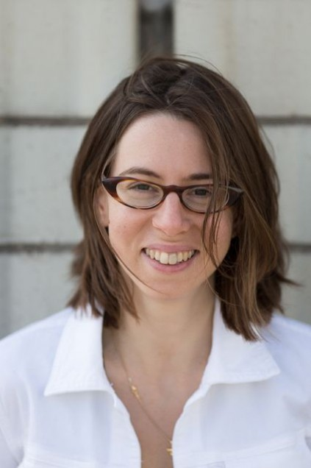
W ashington A rea T rustworthy C omputing H our
43rd WATCH:
Securing the Network Time Protocol
Sharon Goldberg
Boston University
Thursday March 16th, 11am, Room 110
(Please note the time change for this WATCH only)
About the WATCH series:
Transforming today’s trusted but untrustworthy cyberinfrastructure into one that can meet society’s growing demands requires both technical advances and improved understanding of how people and organizations of many backgrounds perceive, decide to adopt, and actually use technology. WATCH aims to provide thought-provoking talks by innovative thinkers with ideas that illuminate these challenges and provide signposts toward solutions. The series is jointly organized by NSF’s Computer Science and Engineering (CISE) and Social, Behavioral, and Economic (SBE) Directorates and sponsored by the CISE Secure and Trustworthy Cyberspace (SaTC) Program. Talks will be recorded and made available over the Internet.
Abstract
Time is a fundamental building block for computing applications, and time synchronization is crucial for the security of many cryptographic protocols and the correctness of many distributed systems. Time on computer clocks is commonly set using the Network Time Protocol (NTP). This talk considers the security of the NTP specification and its reference implementation ntpd. We consider various threats to NTP that allow an attacker to either (a) alter time on computer systems that set their clocks using NTP (timeshifting attacks), or (b) prevent those systems from synchronizing their clocks (denial of service attacks). We also discuss protocols that can secure NTP against these classes of attacks.
Speaker
Sharon Goldberg is an associate professor in the Computer Science Department at Boston University. Her research uses tools from theory (cryptography, game-theory, algorithms), and networking (measurement, modeling, and simulation) to solve practical problems in network security. She received her Ph.D. from Princeton University in 2009, her B.A.Sc. from the University of Toronto in 2003, has worked as a researcher at IBM, Cisco, and Microsoft, as an engineer at Bell Canada and Hydro One Networks, and has served on working groups of the Federal Communications Commission (FCC) and the Internet Engineering Task Force (IETF). In 2014 she received two IETF/IRTF Applied Networking Research Prizes, an NSF CAREER Award, and a Sloan Research Fellowship.
Thursday, Mar. 16, 2017
Questions/comments about WATCH?
Contact Nina Amla (namla@nsf.gov)
NSF Stafford I Room 110, 11am
Public Invited

