Slide 1
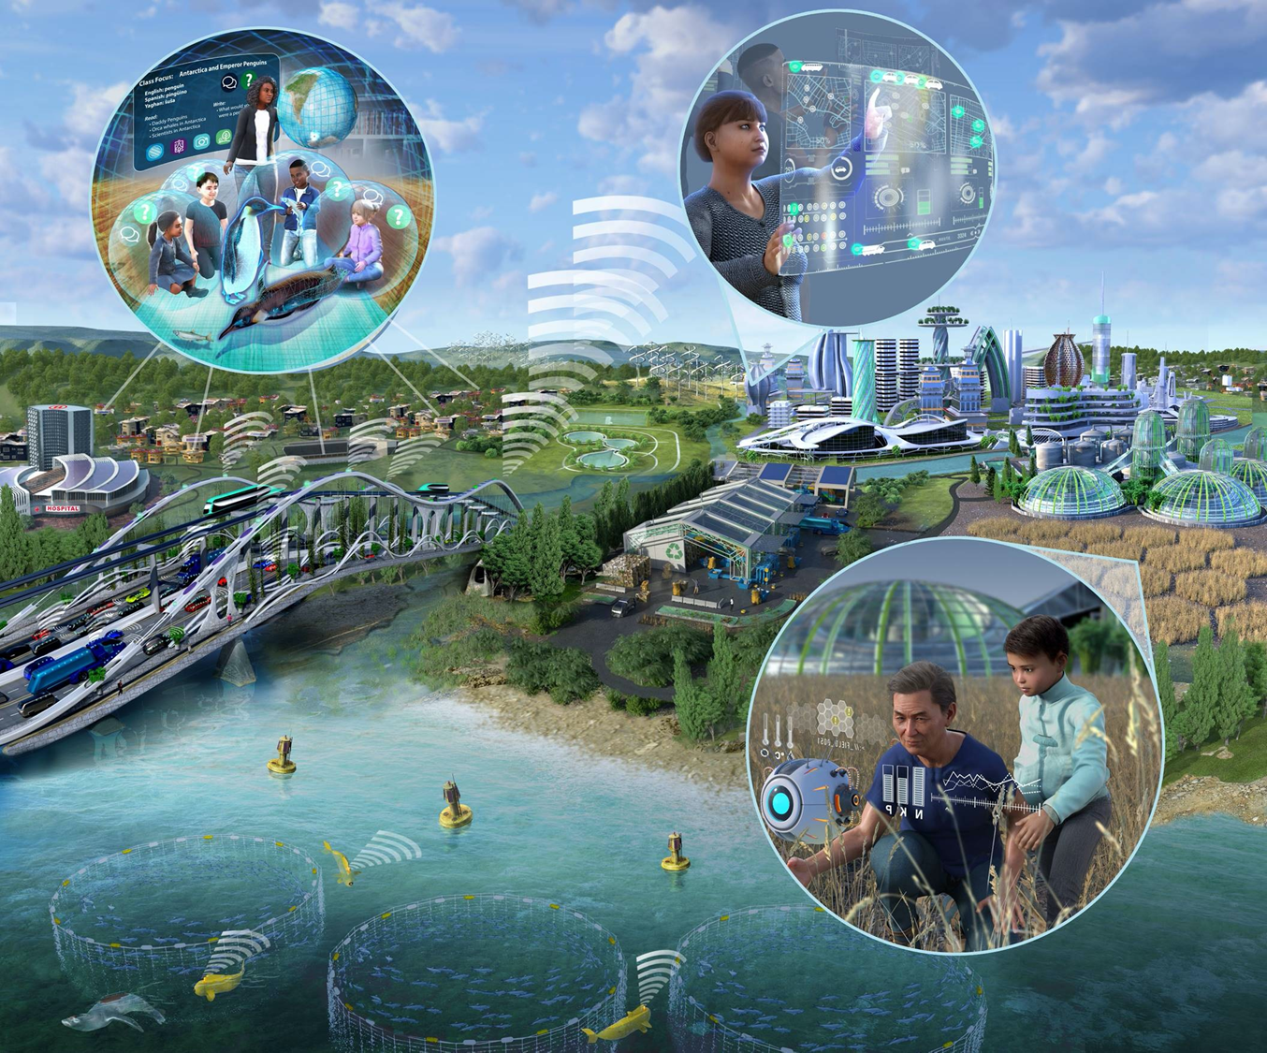
NSF 23-543 The Future of Work at the Human-Technology Frontier: Core Research
Proposal Deadline
March 30, 2023
Overview of the
FW-HTF program
* See notes for audio transcripts
Notes:
This presentation will highlight key requirements of the National Science Foundation’s FY 2023 solicitation number NSF 23-543, “Future of Work at the Human-Technology Frontier: Core Research.” The intent is to provide guidance and clarification for prospective PIs to submit a responsive proposal by the March 30th deadline.
This presentation is not a substitute for the solicitation. Prospective PIs should read the solicitation carefully, as the solicitation establishes the definitive requirements for the FY2023 competition.

Slide 2
FW-HTF Structure
Steering Committee
CISE: Michael Littman
EDU: Evan Heit
ENG: Alexis Lewis †
SBE: Rayvon Fouché †
TIP: Barry Johnson
† Steering Committee Co-Chairs
CISE AD: Margaret Martonosi
EDU AD: James Moore
ENG AD: Susan Margulies
SBE AD: Kellina M. Craig-Henderson
TIP AD: Erwin Gianchandani
Working Group
CISE: David Corman, Dan Cosley
EDU: Martha James, Julie Johnson, Alexandra Medina-Borja*, Katelyn Schreyer
ENG: Jordan Berg*, Daniel McAdams, Leon Shterengas
SBE: Sara Kiesler, Betty Tuller
TIP: Linda Molnar, Debora Rodrigues
Stewarding Unit
ENG/EFMA: Sohi Rastegar
* Working Group Co-Chairs
2
Notes:
FW-HTF is led by the Engineering and Social and Behavioral Science Directorates, joined by the CISE, EDU Directorates and the new TIP directorate. The program is stewarded by the ENG / EFMA office.
FW-HTF is overseen by a Steering Committee comprising Division Directors from ENG, SBE, CISE, EDU and TIP.
Day-to-day operations of FW-HTF are carried out by a Working Group that models and reflects the interdisciplinary ambitions of the program. Funding recommendations are also made by this interdisciplinary group.

Slide 3
Important Changes and Revisions
Since the FY22 Solicitation
Notes:
We are going to go over a few important revisions and changes that appear in the FY2023 solicitation.

Slide 4
Removed restrictions for individuals to participate in multiple proposals as Senior Personnel or Consultants
Individuals may now appear as senior personnel or consultants on multiple proposals submitted to this solicitation.
Individuals can still appear as PI or co-PI on only one proposal. This limitation will be strictly enforced.
Notes:
The previous version of this solicitation required that individuals could be listed as PI, co-PI, senior personnel, or consultants on only one proposal submitted to a given solicitation. Individuals may now appear as senior personnel or consultants on multiple proposals submitted to this solicitation. Individuals are still restricted to serve as PI or co-PI on only one proposal submitted to the program. This limitation will be strictly enforced.

Slide 5
The FW-HTF program no longer accepts proposals in the “Project Development” (FW-HTF-P) category.
Proposals with focused objectives and limited resource requirements should submit to the Research Medium (-RM) category.
Notes:
The program no longer accept proposals in the project development category. However, the ranges and scope of the research categories are flexible and wide enough to support a small research grant, if appropriate to the intended scope of the project.
Please submit proposals with focused objectives and limited resource requirements -- such as were previously provided by the FW-HTF-P category -- to the FW-HTF-RM (Research Medium) category.

Slide 6
The FW-HTF program no longer accepts proposals in the "Transition-to-Scale" (FW-HTF-T) category.
Projects testing research questions at scale may be submitted to the FW-HTF-RM or FW-HTF-RL categories.
DCL 23-047 describes a supplemental funding mechanism to support extensions to current FW-HTF research awards, including those that consider research questions of scaling.
Notes:
The FW-HTF program no longer accepts proposals in the "Transition-to-Scale" (FW-HTF-T) category.
Please submit new proposals exploring fundamental research questions of scaling to the Research Medium or Large categories.
Also, a newly published DCL 23-047, describes a supplemental funding mechanism to support research extensions to current FW-HTF-R awards that have the potential to increase the societal benefits of the research outcomes. This includes extensions that consider research questions of scaling, or other translational research questions. Please consult DCL 23-047 for details of this mechanism.

Slide 7
FY23 Research proposals may be submitted in one of two budget intervals for up to 4 years
FW-HTF accepts FY23 proposals in the following budget ranges:
“Research Medium” proposals (FW-HTF-RM) with budgets up to $1M, and
“Research Large” proposals (FW-HTF-RL) with budgets above $1M, and up to $2M.
All proposal budgets should be justified by project scope, required resources, and envisioned outcomes.
Notes:
To summarize the revisions and changes implemented in FY23 (since the last FY22 solicitation):
The FW-HTF program now accepts two categories of research proposals, namely "Research Medium" proposals (FW-HTF-RM) and "Research Large" proposals (FW-HTF-RL).
FW-HTF-RM proposals have budgets up to $1M, and
FW-HTF-RL proposals have budgets above $1M and up to $2M.
All FW-HTF-R proposals may have a duration of up to four years.
All proposal budgets should be justified by project scope, required resources, and envisioned outcomes.

Slide 8
FW-HTF Core Research Program
Overview of the Program
Notes:
Now we are going to provide an overview of the fundamental concepts and requirements of the FW-HTF program

Slide 9
The Challenge
The landscape of jobs and work is changing at unprecedented speed, enabled by advances in areas including emerging engineering technologies and new results in computer science; deeper understanding of societal and environmental change; advances in the learning sciences; development of pervasive, intelligent, and autonomous systems; and novel conceptions of work and workplaces.
This technological and scientific revolution offers historical opportunities, but also comes with risks, including jobs lost to automation, strains on educational resources, security and privacy threats, algorithmic bias, overdependence on technology, and the erosion of human skills.
Notes:
First, let’s talk about the he Challenge that the program aims to respond to:
* The landscape of jobs and work is changing at unprecedented speed, enabled by advances in areas including emerging engineering technologies and new results in computer science; deeper understanding of societal and environmental change; advances in the learning sciences; development of pervasive, intelligent, and autonomous systems; and novel conceptions of work and workplaces.
* This technological and scientific revolution offers historical opportunities, but also comes with risks, including jobs lost to automation, strains on educational resources, security & privacy threats, algorithmic bias, overdependence on technology and the erosion of human skills.

Slide 10
FW-HTF Vision
The overarching vision of the FW-HTF program is to support convergent research within the context of work to…
Understand and advance the human-technology partnership;
Develop new technologies to augment human performance;
Foster lifelong and pervasive learning;
Promote workers’ well-being and quality of life; and
Illuminate the emerging socio-technological landscape and understand the risks and benefits of new technologies.
Notes:
The Future of Work at the Human-Technology Frontier Vision
The overarching vision of the FW-HTF program is to support convergent research within the context of work, in order to…
Understand and advance the human-technology partnership;
Develop new technologies to augment human performance;
Foster lifelong and pervasive learning with technology;
Promote workers’ well-being and quality of life; and
Illuminate the emerging socio-technological landscape and understand the risks and benefits of new technologies.

Slide 11
Focus on Work
For the purposes of the FW-HTF solicitation, work is defined as mental or physical activity to achieve income, profit, or other tangible benefit.
Projects must address a well-defined form of work or workplace domain with the purpose of creating new or improved partnerships of technology and human workers.
Research questions must intentionally target the future of work with a conceptualization of future work at the human-technology frontier that is embedded in its social and economic context.
Notes:
Focus on Work:
For the purposes of the FW-HTF solicitation, work is defined as mental or physical activity to achieve income, profit, or other tangible benefit.
Projects must address a well-defined form of work or workplace domain with the purpose of creating new or improved partnerships of technology and human workers.
Research questions must intentionally target the future of work with a conceptualization of future work at the human-technology frontier that is embedded in its social and economic context.

Slide 12
The FW-HTF Program
Convergent research integrating…
Future Work: Societal, economic, professional, occupational, industrial, educational, or national context
Future Workers: Workers as individuals or in teams, including education & training
Future Technology: Technologies to develop the human-technology partnership in future workspaces
All three elements should be synergistic components of the Intellectual Merit
Projects may weight these elements differently, but all should be present
Notes:
The FW-HTF Program
Projects are welcome that advance a convergent research approach, integrating and meaningfully relating future work, future technology, and future workers in a cohesive integrated effort, in which all three elements can be recognized, but none can be isolated from the others.
* This interrelationship can be visualized as three interlocking rings.
* The upper ring represents future technology: the engineering or computer science technologies that will develop the human-technology partnership in future workspaces, including offices, classrooms, warehouses, farms, & factories.
* The ring on the lower right represents future workers: considering their interests and well-being as individuals or in teams, including education and training.
* The ring on the lower left represents future work within a societal, economic, professional, occupational, industrial, educational, or national context.
* The FW-HTF program solicits projects in which all three elements are present and synergistic.
* Projects responsive to the 2023 FW-HTF solicitation may be anchored within any of the three areas as a primary component. Project leadership and personnel should reflect the proposed research objectives in all three areas.

Slide 13
Future Work, Future Workers, Future Technology
Proposal narratives may describe research questions in the areas of future workers, future technology, and future work.
Preference will be given to convergent proposals that show clear intellectual merit in all three areas.
To facilitate the evaluation of these elements, it is strongly recommended that proposals address each one in separate and clearly labeled subsections of the Project Description, which should also describe the synergistic interactions between these research elements.
Notes:
Proposal narratives may describe research questions in the areas of future workers, future technology, and future work.
Preference will be given to convergent proposals that show clear intellectual merit in all three areas.
To facilitate the evaluation of these elements, it is strongly recommended that proposals address each one in separate and clearly labeled subsections of the Project Description, which should also describe the synergistic interactions between these research elements.

Slide 14
Objectives of the FW-HTF Program
Facilitate convergent research that employs the joint perspectives, methods, and knowledge of different disciplines;
Develop deeper understandings of how human needs in the workplace can be met;
Support deeper understanding of the societal infrastructure that leads to new work technologies, new approaches to work, and prepares people for the future of work;
Encourage the development of a research community dedicated to designing intelligent technologies, work organization, jobs and modes inspired by their positive impact on individual workers and the way workers adapt to technological change;
Promote deeper understanding of the interdependent human-technology partnership, including how adults learn the new skills needed in the workplace, and improving accessibility;
Mitigate potential risks arising from future work at the human-technology frontier.
Notes:
Objectives:
The specific objectives of the FW-HTF program are to …
Facilitate convergent research that employs the joint perspectives, methods, and knowledge of different disciplines;
Develop deeper understandings of how human needs in the workplace can be met;
Support deeper understanding of the societal infrastructure that leads to new work technologies, new approaches to work, and prepares people for the future of work;
Encourage the development of a research community dedicated to designing intelligent technologies, work organization, jobs and modes inspired by their positive impact on individual workers and the way workers adapt to technological change;
Promote deeper understanding of the interdependent human-technology partnership, including how adults learn the new skills needed in the workplace, and improving accessibility;
Mitigate potential risks arising from future work at the human-technology frontier.

Slide 15
Proposal Requirements
MUST address a well-defined form of work or workplace domain to create new or improved partnerships of technology and human workers;
MUST focus on advancing fundamental understanding of future work, and potential improvements to work, workplaces, workforce preparation, or work outcomes for workers and society;
MUST be convergent research that addresses technological as well as human and societal dimensions; and
MUST incorporate a conceptualization of future work that is embedded in a social and economic context.
The ideal FW-HTF proposal is unlikely to align with the mission of any other NSF program
Notes:
Proposal Requirements:
Proposals that are responsive to the FY23 solicitation:
MUST address a well-defined form of work or workplace domain to create new or improved partnerships of technology and human workers (including specifying the O*NET code that best matches the envisioned future occupation);
MUST focus on advancing a fundamental understanding of future work, and potential improvements to work, workplaces, workforce preparation, or work outcomes for workers and society;
MUST propose convergent research that addresses technological as well as human and societal dimensions; and
MUST incorporate a conceptualization of future work that is embedded in a social and economic context.
The ideal FW-HTF proposal is unlikely to align with the mission of any other NSF program.

Slide 16
Proposal Submission Deadline
All FY23 FW-HTF proposals:
Due by 5 PM submitter’s local time on March 30, 2023
Notes:
The Proposal Submission Deadline is March 30, 2023
Proposals must be submitted by 5 PM local time on March 30, 2023.

Slide 17
Eligibility Requirements
PIs must hold an appointment at the US-based campus or office of an eligible Institution of Higher Education or non-profit organization.
There are no restrictions beyond those outlined in the PAPPG on who may serve as Co-PI, Senior Personnel, or Consultant.
An individual may appear as PI or Co-PI on only one proposal submitted in response to the FY 2023 FW-HTF solicitation. Subsequent submissions will be returned without review.
This eligibility constraint will be strictly enforced!
Notes:
Eligibility Requirements
PIs must hold an appointment at the US-based campus or office of an eligible Institution of Higher Education or non-profit organization.
There are no restrictions beyond those outlined in the PAPPG on who may serve as Co-PI, Senior Personnel or Consultant.
An individual may appear as PI, or Co-PI, on only one proposal submitted in response to the FY 2023 FW-HTF solicitation.
Subsequent submissions will be returned without review.
This eligibility constraint will be strictly enforced!

Slide 18
Proposal Categories
Two Categories of FW-HTF proposals:
Research Medium (FW-HTF-RM) projects with a total budget not to exceed $1,000,000 for a period of up to 4 years.
Research Large (FW-HTF-RL) projects with a total budget greater than $1,000,000 and not to exceed $2,000,000.
Grant budget should be justified by project scope, required resources, and envisioned outcomes.
No previous FW-HTF grant is required for submission in any category.
Notes:
As said before, FW-HTF Research Grants now support two budget categories in this FY23 competition:
-Medium (FW-HTF-RM) projects will provide support for a period of up to 4 years, with a total budget not to exceed $1,000,000.
-Large (FW-HTF-RL) projects will provide support for a period of up to 4 years, with a total budget greater than $1,000,000 and not to exceed $2,000,000.
The FW-HTF program accepts projects that span a wide range of budget sizes. The Project Description should explain why the level of resources requested (e.g., personnel, travel, equipment) is needed to achieve the desired project impacts and how the budget is appropriate to the scope of work.

Slide 19
All FW-HTF Proposals: Required Sections
In addition to the required sections described in the PAPPG, the Project Description of all FW-HTF proposals MUST include the following separate sections, clearly labeled with the specified headings:
A Work Context section to clearly identify and define the work domain, workers, and workplaces;
An Integrative Research section to describe how knowledge, techniques, and expertise from;
A Methods, Measures, and Metrics section to describe how progress and outcomes of the project will be assessed.
An Access & Inclusion section to address enhancing the future workplace inclusion and equity with the proposed work.
Notes:
Additional Sections Required
In addition to the standard required sections described in NSF’s Proposal & Award Policies & Procedures Guide, or PAPPG, the Project Description of an FW-HTF proposal MUST include the following separate sections, clearly labeled with these specified headings:
Work Context – This section will clearly identify and define the work domain, workers, and workplaces, and the scope and scale of outcomes and benefits envisioned;
Integrative Research – This section will describe how knowledge, techniques, and expertise from multiple fields and sectors will create new and expanded frameworks for addressing research goals;
Methods, Measures, and Metrics – This section will describe how progress and outcomes of the project will be assessed.
Access and Inclusion – This section should address meaningful enhancements to inclusion and equity in the context of the Future of Work. The expectation is that aspects of how the proposed work will enhance the future workplace are addressed here.

Slide 20
Other Requirements: O*NET Code and Keywords
Proposals must specify O*NET code or codes corresponding to the job of focus. Overly general projects that do not correspond to a particular job are not appropriate for FW-HTF.
Proposals must also specify three key words corresponding to the future work, future worker, and future technology in the proposal.
Notes:
Two additional requirements should be noted.
Proposals must specify O*NET code or codes corresponding to the job of focus. Overly general projects that do not correspond to a particular job are not appropriate for FW-HTF. (See supplemental webinar for guidance/instructions on O*NET codes)
Proposals must also specify three key words corresponding to the future work, future worker, and future technology in the proposal.

Slide 21
Supplemental Documents Required
In addition to the Supplemental Documents described by the PAPPG, proposals MUST include the following:
A Management and Coordination Plan describing specific steps the project team plans to take to achieve the goal of convergent research, in which knowledge, techniques, and expertise from multiple fields and sectors create new and expanded frameworks for addressing research goals;
A List of Project Personnel and Partner Institutions providing current, accurate information for all personnel and institutions involved in the project.
Notes:
In addition to the Supplemental Documents described by the PAPPG, all proposals MUST include:
A Management and Coordination Plan - describing specific steps the project team plans to take to achieve the goal of convergent research, in which knowledge, techniques, and expertise from multiple fields and sectors create new and expanded frameworks for addressing research goals;
A List of Project Personnel and Partner Institutions - providing current, accurate information for all personnel and institutions involved in the project.

Slide 22
New PAPPG Effective January 30, 2023!!
Research.gov
"Concept Outlines"
Expands training requirements for Responsible and Ethical Conduct of Research
Certification of Safe and Inclusive Working Environments for off-campus research
SciENcv for Bio Sketch and Current and Pending Support
Implementation of Build America, Buy America statutes.
New sections on Disclosures, Research Security and Scientific Integrity.
Other changes too!
Notes:
The new PAPPG effective January 30, 2023 comes with several revisions and new requirements that we encourage you to review with your Office of Sponsored Programs. There are several new forms and certifications that need to be incorporated in your 2023 submission.

Slide 23
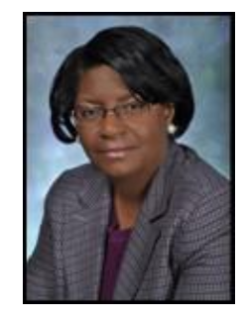
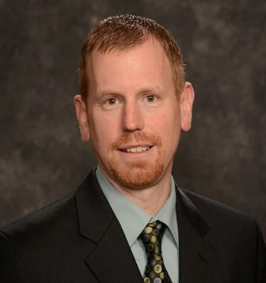
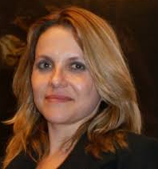
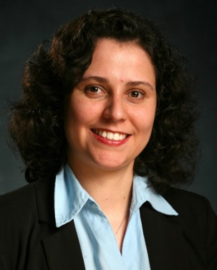
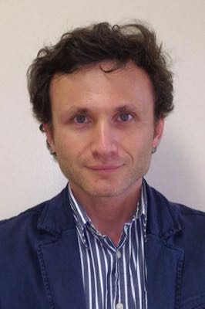
Cognizant Program Officers
Jordan Berg
David Corman
Dan Cosley
Martha James
Julie Johnson
Sara Kiesler
Daniel McAdam
Alexandra Medina-Borja
Debora Rodrigues
Leon Shterengas
Betty Tuller
Linda Molnar
Notes:
On behalf of the Program Officers serving the Future of Work at the Human Technology Frontier program…

Slide 24
Resources
Thank you for your interest
NSF 23-543: Future of Work at the Human-Technology Frontier: Core Research (FW-HTF)
We look forward to receiving your submissions by March 30th
Please address questions to the cognizant program officers at:
fwhtf-contacts@nsf.gov
Visit our website for past Awards and additional information:
www.nsf.gov/futureofwork
Notes:
… we thank you for your interest in solicitation NSF 23-543: the Future of Work at the Human-Technology Frontier: Core Research program.
We look forward to receiving your submissions by March 30th, 2023.
For additional information or questions, please contact the program officers at fwhtf-contacts@nsf.gov, and visit our landing page website at www.nsf.gov/futureofwork

Slide 25
Other Resources for Prospective PIs
Presentations:
Overview of the FW-HTF program (this presentation)
Introduction to O*NET
Webinar Series / Office Hours. Register at Webinar Registration - Zoom (zoomgov.com).
Upcoming Office Hours (times and days):
Wednesday, February 1, 2023 9:30 AM-11:30 AM ET
Thursday, February 2, 2023 3:00 PM-5:00 PM ET
Friday, February 10, 2023 2:30 PM-4:30 PM ET
Thursday, February 16, 2023 9:30 AM-11:30 AM ET
Notes:
Additional resources for PIs include:
Presentations:
Overview of the FW-HTF program (this presentation)
Introduction to O*NET
Program Officers will offer Office Hours in the format of zoom webinar on four different days and times:
Wednesday, February 1, 2023 9:30 AM-11:30 AM ET
Thursday, February 2, 2023 3:00 PM-5:00 PM ET
Friday, February 10, 2023 2:30 PM-4:30 PM ET
Thursday, February 16, 2023 9:30 AM-11:30 AM ET
Please register using the link provided

