Slide 1
United States Antarctic Program
Research Support Overview
Brian W. Stone
Division Director
Antarctic Infrastructure & Logistics

Slide 2
Our Support Concept
Take top quality researchers from U.S. institutions and put them into Antarctica each year for short and long term observations.
We do this by using the operations and logistics capabilities and the investment in fixed facilities made over the past 56 years.
Anyone can be a polar explorer.

Slide 3
Overview
Permanent Stations
  McMurdo Station
  South Pole Station
  Palmer Station
Field sites
Research vessels
Transportation and other dual-use capabilities

Slide 4
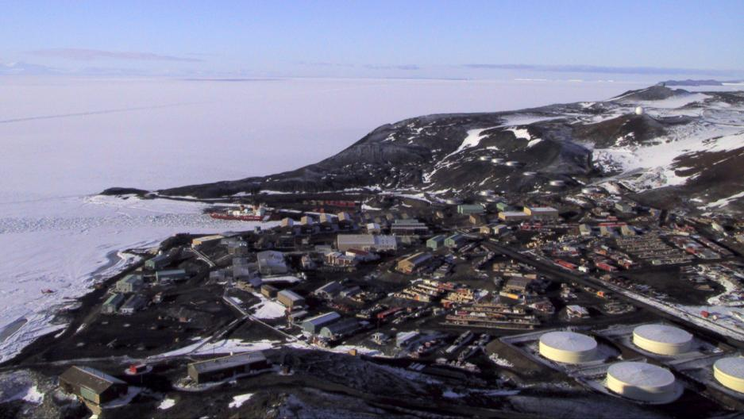
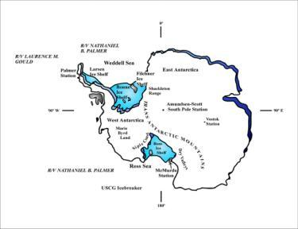
McMurdo Station
McMurdo is located on the
southern tip of Hut Point
Peninsula on Ross Island
Summer (1 Oct to 25 Feb)
900-1050 persons
-20 to 30ºF
Winter 100-200 persons
-30 to -60ºF
Major Science
Sea Ice (mechanics, chemistry, biology)
Geology and Volcanology
Upper atmosphere/astronomy
Gateway to Dry Valleys
Gateway to penguin colonies

Slide 5
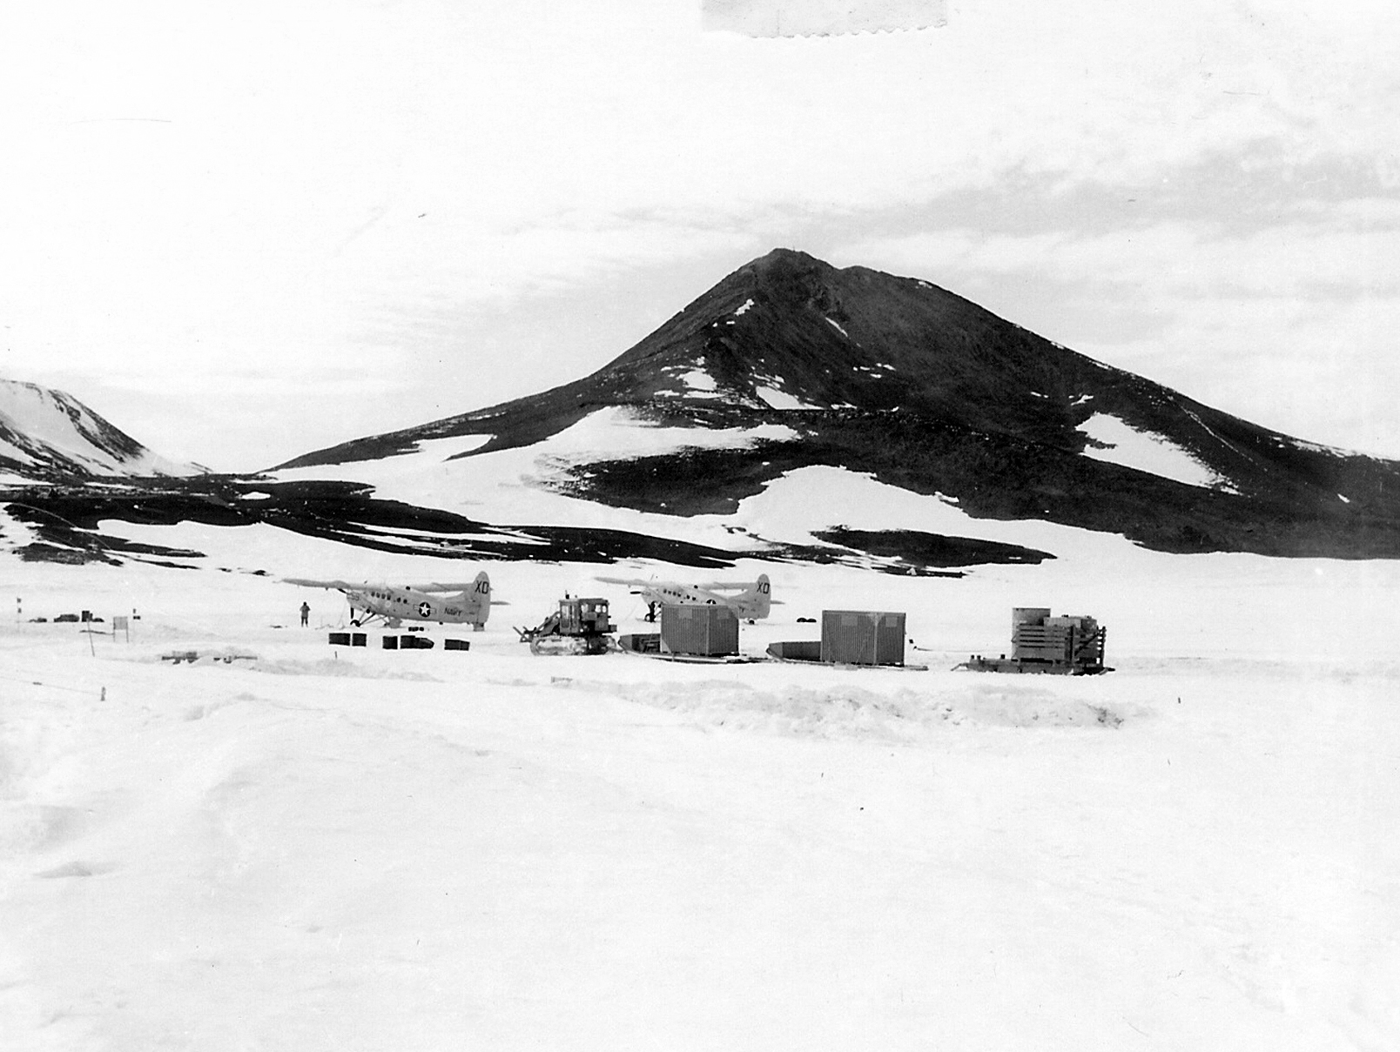
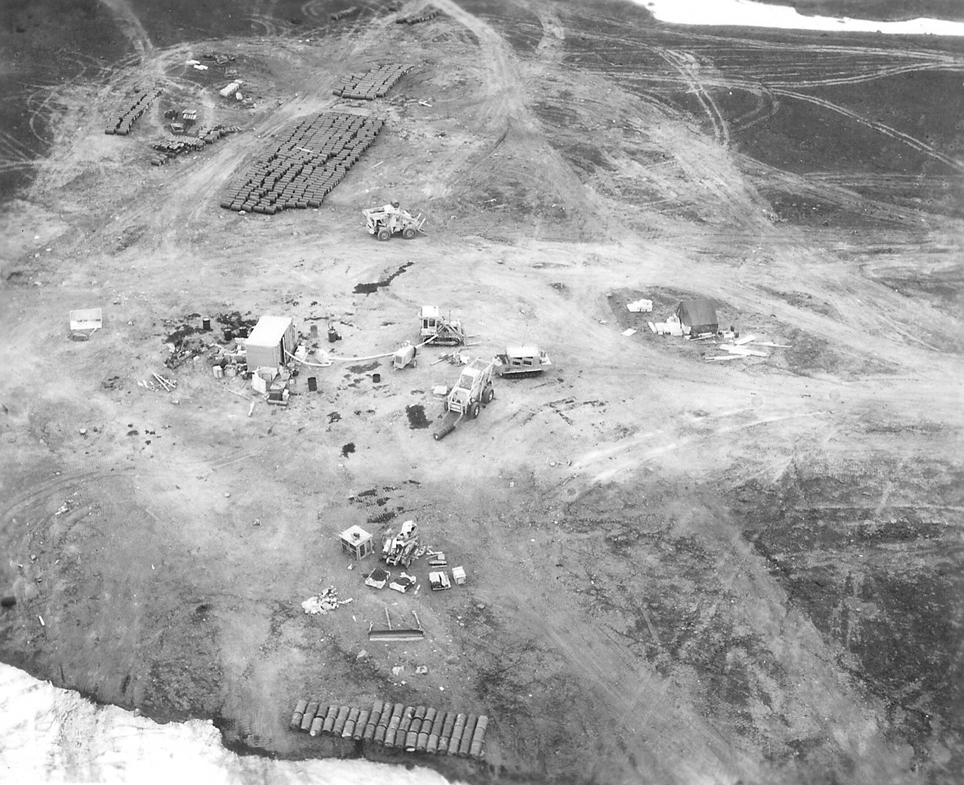
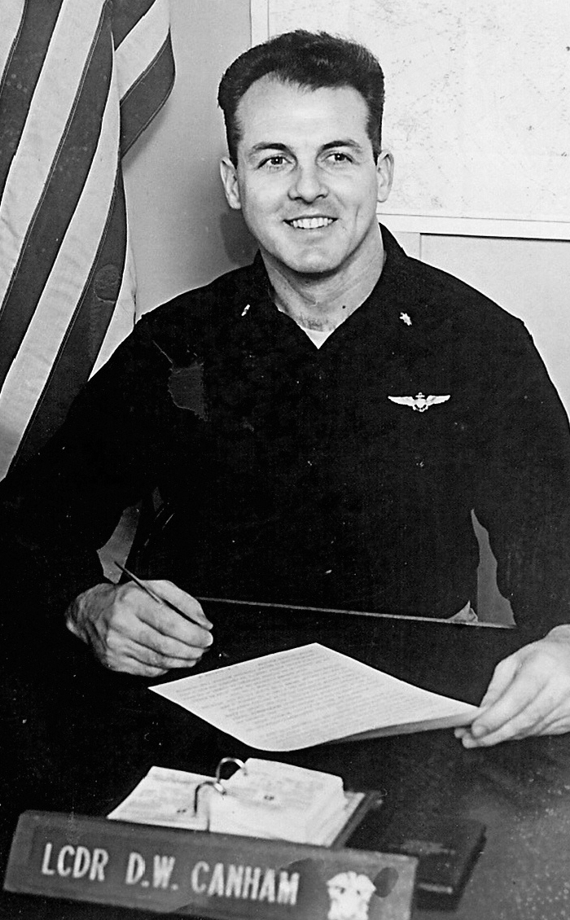
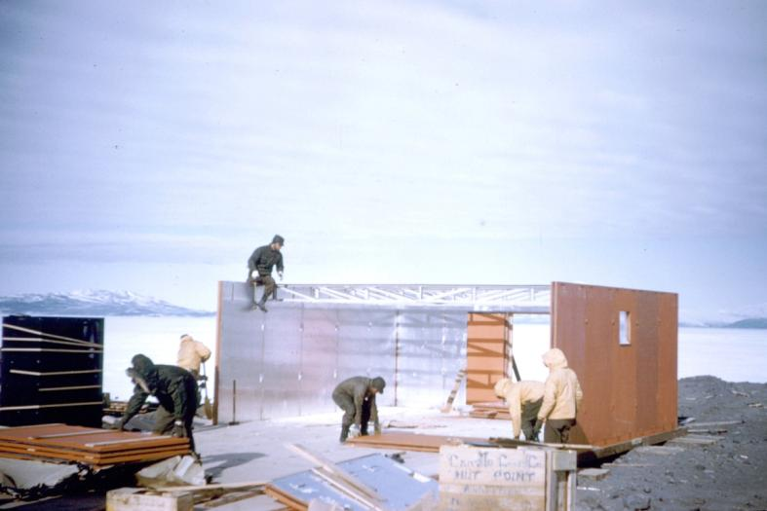
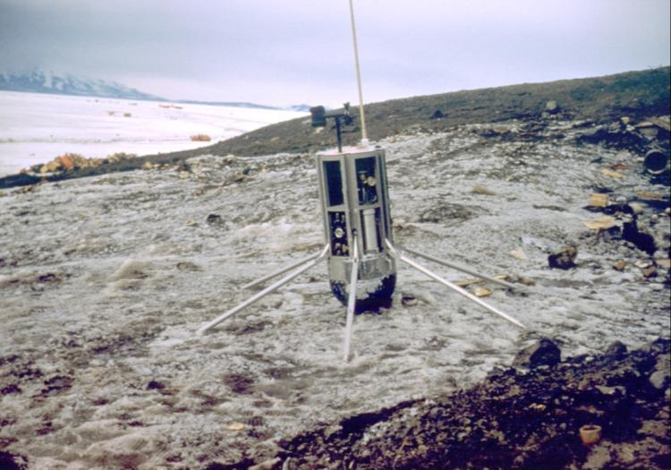
December 1955
January 1956
Clements hut
Nuclear AWS

Slide 6
McMurdo Station
Major Civil Infrastructure
~85 buildings (1956 to 1996)
~15 miles of gravel roads
~20 miles of major snow roads
3 airfields
  sea ice runway (annual new construction; Oct thru Nov)
  compressed snow skiway (major annual rebuild; Dec thru Feb)
  white ice over glacial ice runway (minor annual rebuild; Nov-Feb; Aug)
6-stand helicopter pad
Floating sea ice wharf
Bulk fuel storage facility

Slide 7
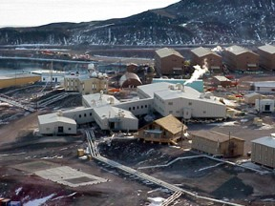
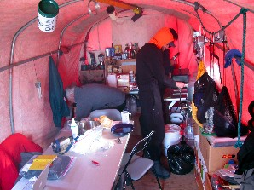
Science Support
McMurdo Station
Logistics hub and field camp preparation
Crary Science and Engineering Center

Slide 8
McMurdo Station Operations
Civil Infrastructure

Slide 9
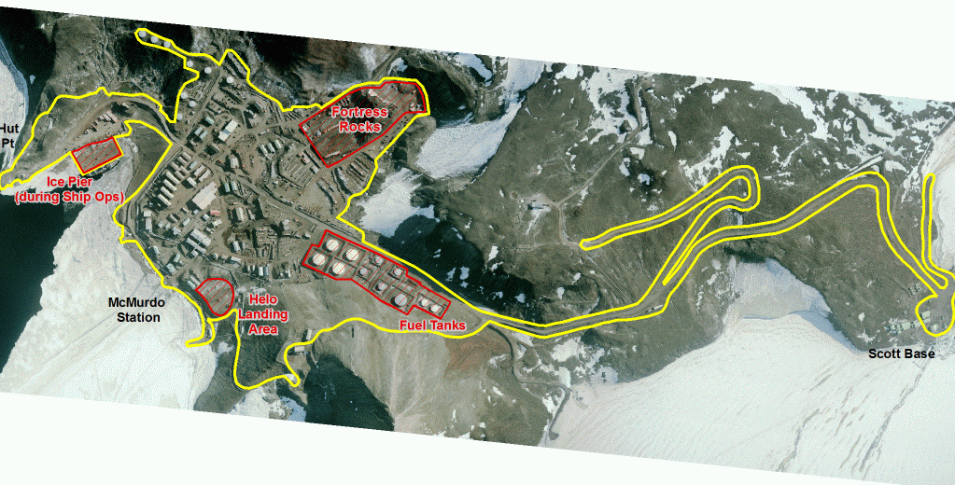
McMurdo Station
Civil Infrastructure

Slide 10
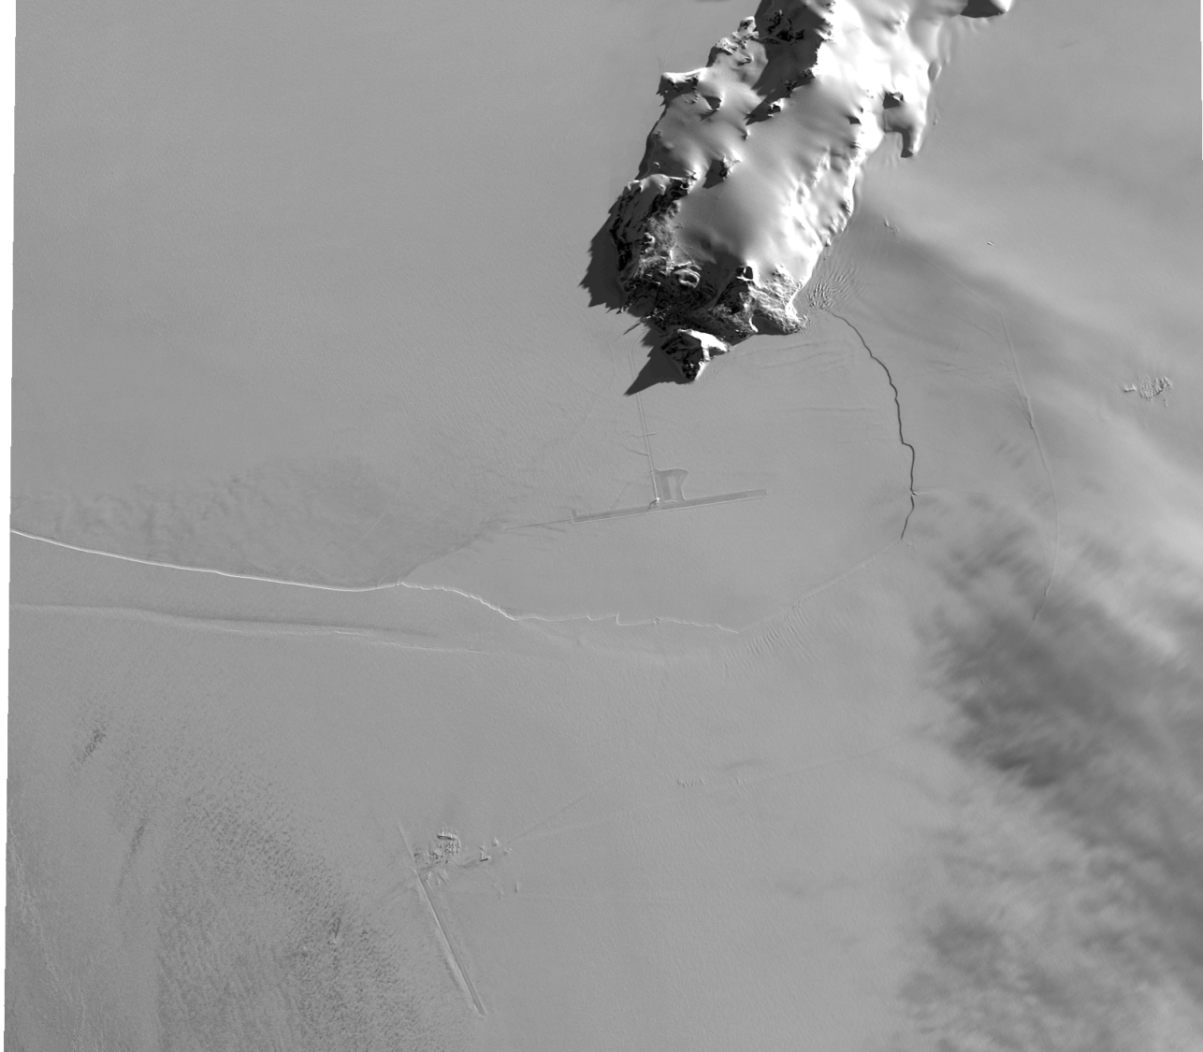
McMurdo Area
September 21, 2011
Satellite Image of McMurdo Area
Williams
Field
Sea Ice Runway
Pegasus Runway

Slide 11
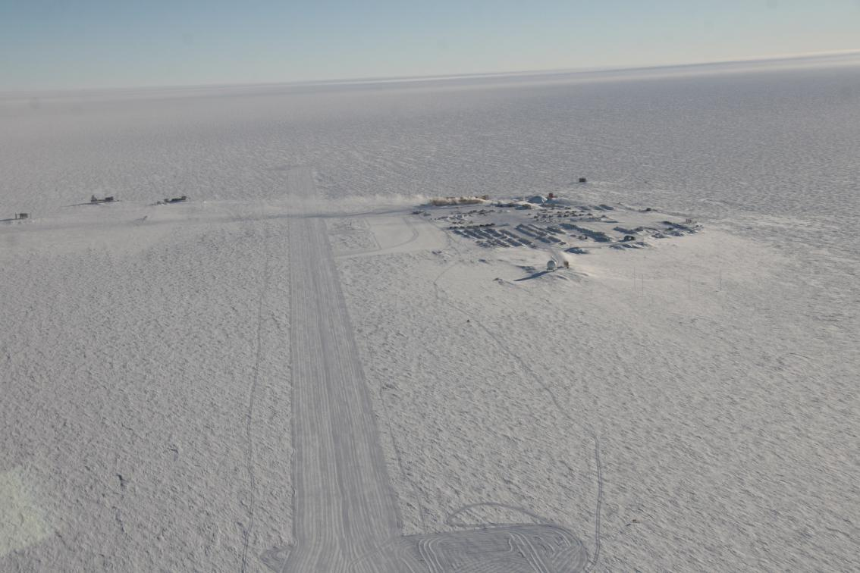
Amundsen – Scott
South Pole Station
5 Miles to SPRESSO
Runway 14,000’
840 Miles to McMurdo

Slide 12
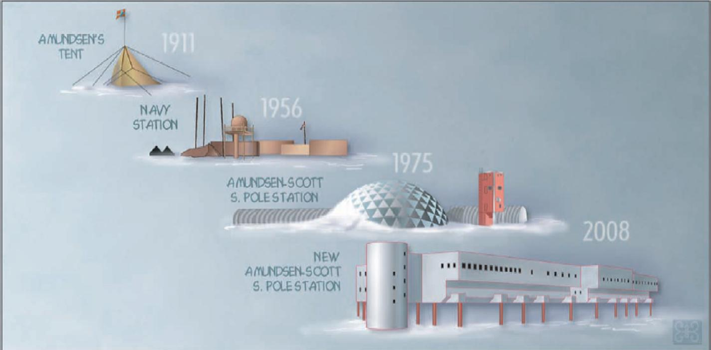
4 South Pole Stations

Slide 13
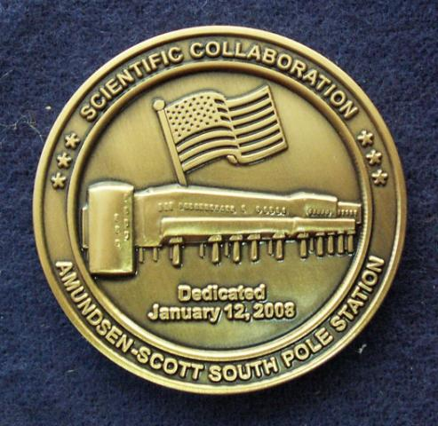
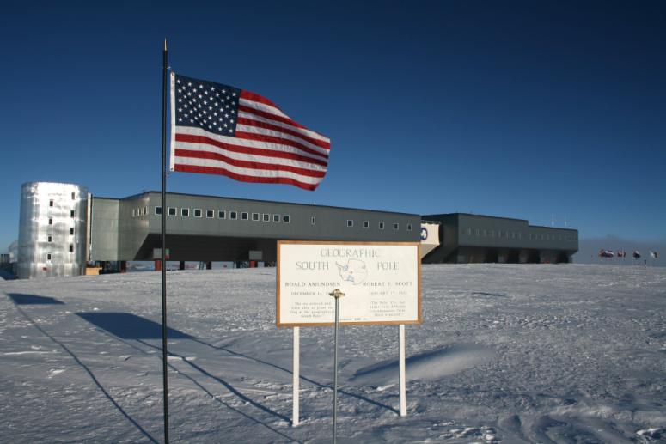
Elevated Station Dedication
January 12, 2008

Slide 14
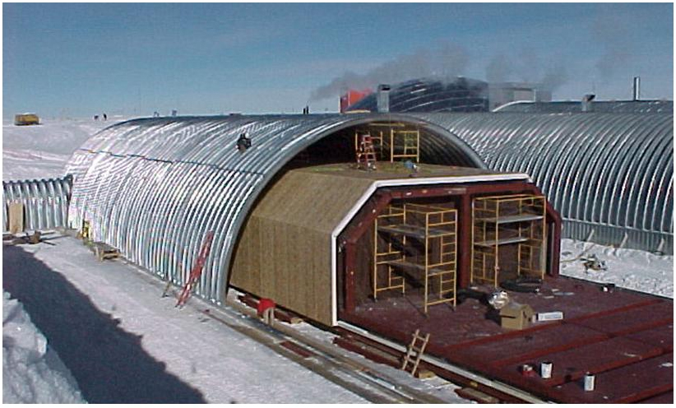
Arch and Building

Slide 15
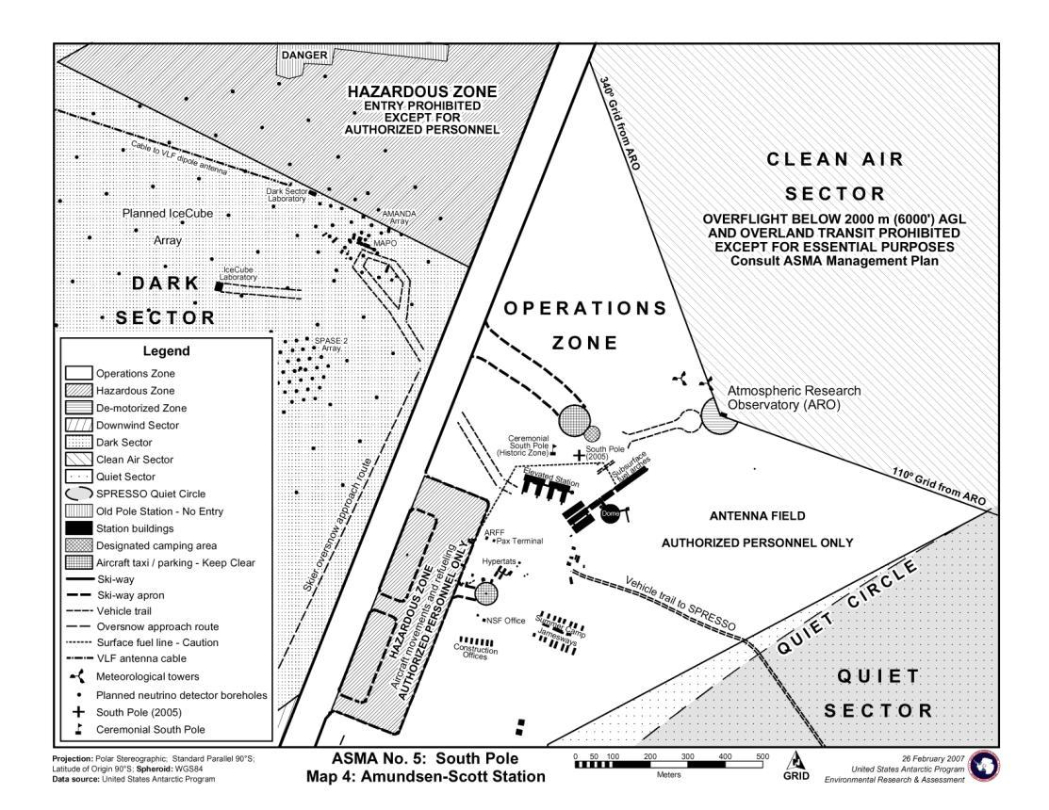
Zoning

Slide 16
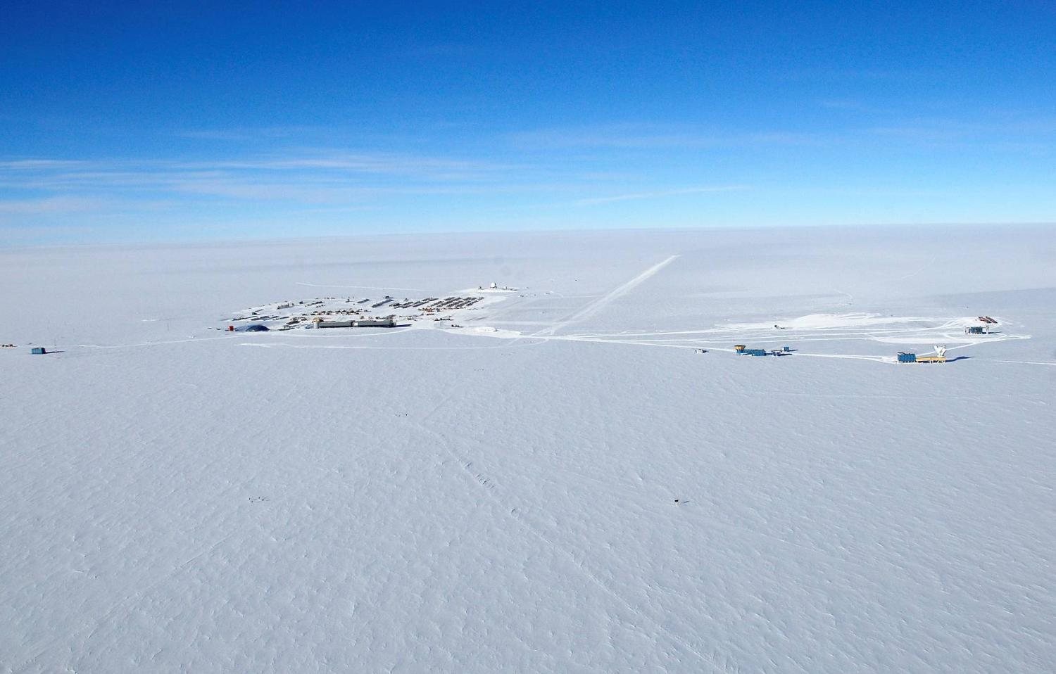
South Pole Science
Elevated Station Area = 65,000 sq ft
Winter = 50 people; Summer = 220 people
Scientific Facilities
  Martin A. Pomerantz Observatory (MAPO)
  Dark Sector Lab (DSL
  IceCube Lab (ICL)
  Atmospheric Research Observatory (ARO)
  B2 Science Lab in Elevated Station
~ 25 projects
  Primarily astronomy and astrophysics projects
  Also
    Atmospheric Science
    Geology and Geophysics
    Glaciology
    Microbiology
ICL
ARO
Elevated Station (B2)
MAPO
DSL

Slide 17
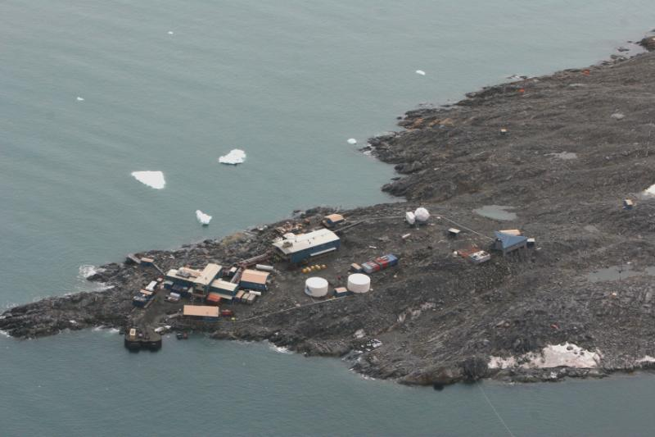
Palmer Station
Palmer Station is located on
Anvers Island on the west side
of the Antarctic Peninsula
Summer (early Sept to mid Mar)
43 persons
+28 to +36ºF
Winter 30-40 persons
+18 to +27ºF
Major Science
Organisms, ecosystems
Ocean science
Biology, chemistry

Slide 18
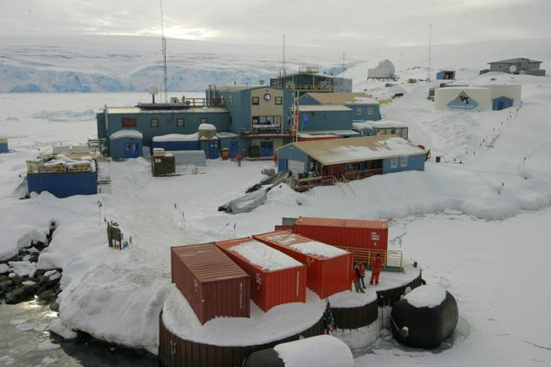
Palmer Station
West Antarctic Peninsula, accessed by vessel only (4 days from Chile)
Summer population 45, winter 18-35, 23-person summer support staff
Two main and five secondary buildings, two large fuel storage tanks and pier (built in 1967)
~15 research projects, mostly marine biology and ecology, remote sensing
Extensively equipped 2,000 sq-ft. laboratory with sea water aquaria
Science operations via Zodiac boats to local waters and islands

Slide 19
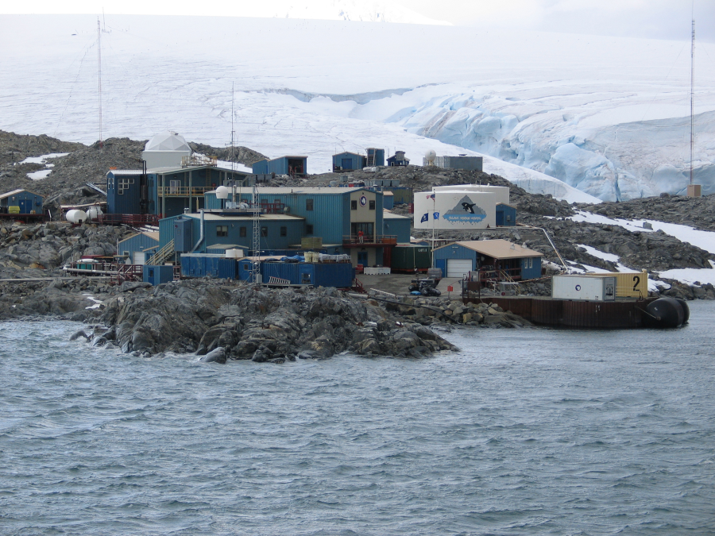
Two fuel types
- Marine diesel (delivered from resupply vessel bunkers)
- Gasoline
Bulk storage facility
- 2 large storage tanks
- distribution system is
via welded pipelines

Slide 20
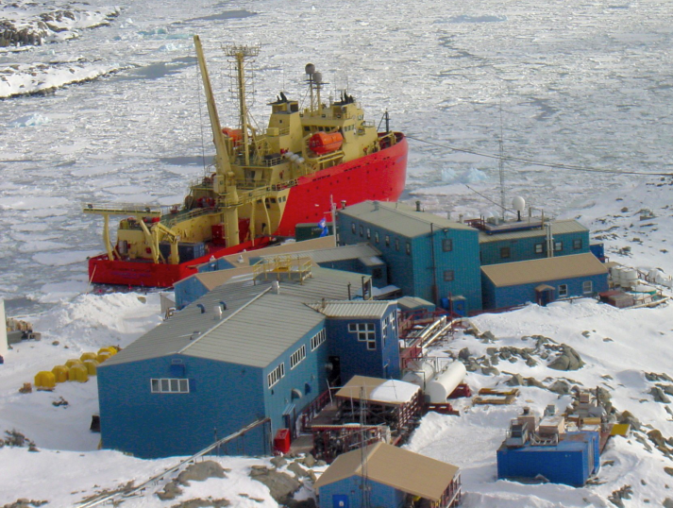
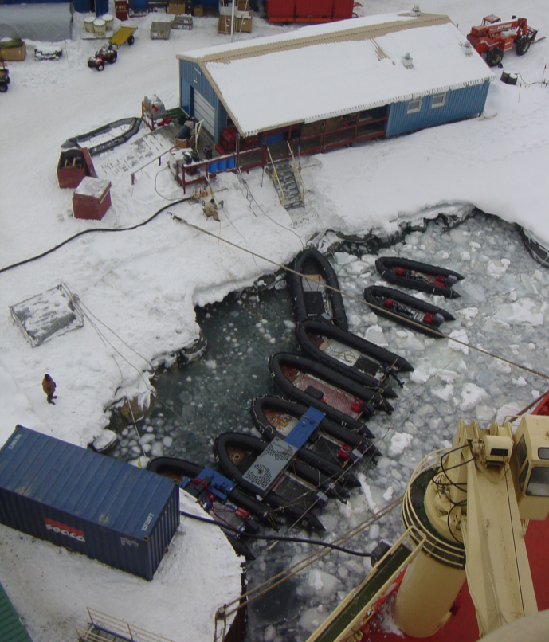
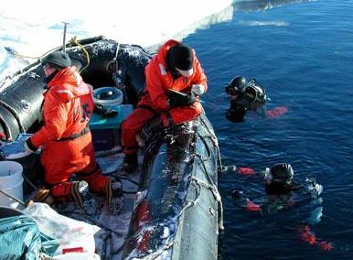

Slide 21
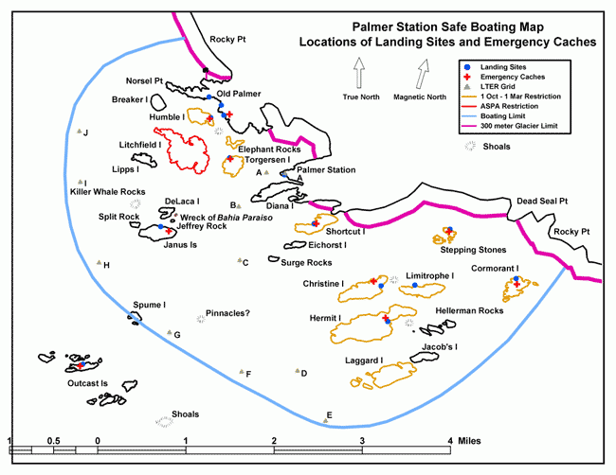
Palmer Station Operations

Slide 22
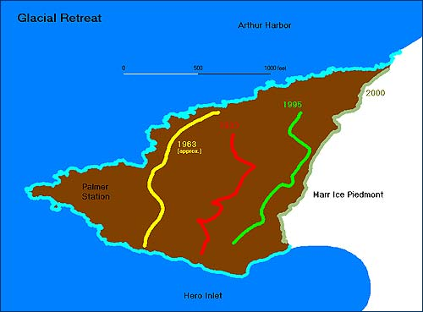
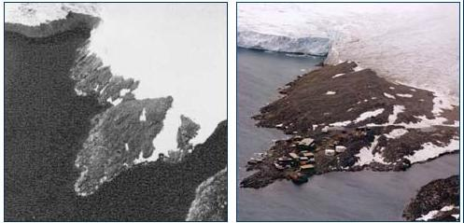
Palmer Station Operations
Palmer area is typical of a cold marine environment
- Many local islands with micro-ecosystems
- Sea ice is ephemeral and exhibits floes, brash and fast conditions at times
Site of station has experienced dramatic glacial retreat
1963
2003

Slide 23
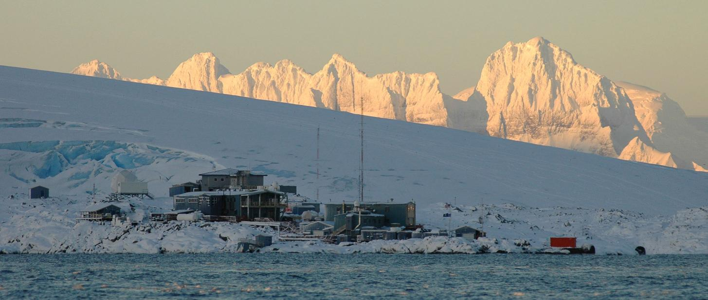

Slide 24
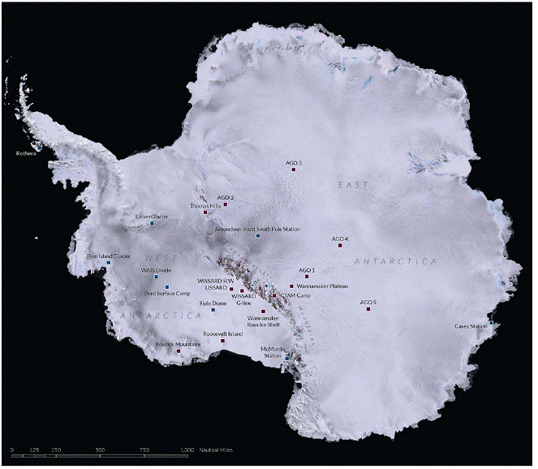
Field Support Sites
Current Trends
Large, complex, integrated projects
Deep field
Access minimally sampled remote areas
PIG Project
- Helicopter field camp at
Pine Island Glacier (PIG) supporting integrated system science
- Supported by surface traverse from Byrd Field camp
- Drilling/instrumenting PIG to access sub-glacial environment (air-glacier-ocean interfaces)

Slide 25
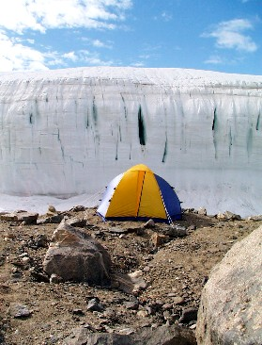
Field Support Sites
Varied Camp Sizes
Contractor supports all field camps, and staffs the larger facilities
    WAIS Divide (deep field camp up to 60 people)
    Lake Hoare (near field camp up to 20 people)
Support includes
    Cargo handling
    Housekeeping
    Construction
    Field Safety
    Camp operations
    Airfield and aviation support
Provides short-term technical field assistance for grantee-run camps
    Mountaineering support
    Field assistant support
Marine Group supports camps from the vessels
    Camps with established facilities (Copa and Cape Shirreff)
    Small temporary tent camps
Notes:
25

Slide 29
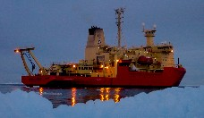
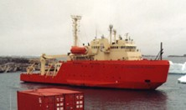
Research Vessels
Nathaniel B. Palmer Lawrence M. Gould
308-foot, 6,800 gross tons, Research Vessel Icebreaker (RVIB) – has supported USAP since commissioning in 1992
Accommodates 39 scientists and support technicians
Over 7,500 sq ft laboratory/science support space
Operates safely year-round in Southern Ocean
Hull rated ABS-A2 - can break 3 feet of ice at 3 knots
Endurance of up to 75 days
Charter expires March 2012; RVIB Rebid in progress
230-foot, 1,600 gross tons, Antarctic Research and Resupply Vessel (ARSV) – has supported USAP since commissioning in 1997
Accommodates 28 researchers and support technicians. Eight additional people accommodated in berthing vans during the Drake Passage crossing.
Over 2,500 sq ft laboratory/science support space
Operates along the Antarctic Peninsula, in the South Shetland Islands, and elsewhere as required.
Transports people and supplies between southern South America and Palmer Station
Hull ice classification of ABS-A1 for moderate pack ice
Endurance of up to 60 days
Charter expires July 2015, with 5 additional 1-year NSF options through 2020

Slide 30
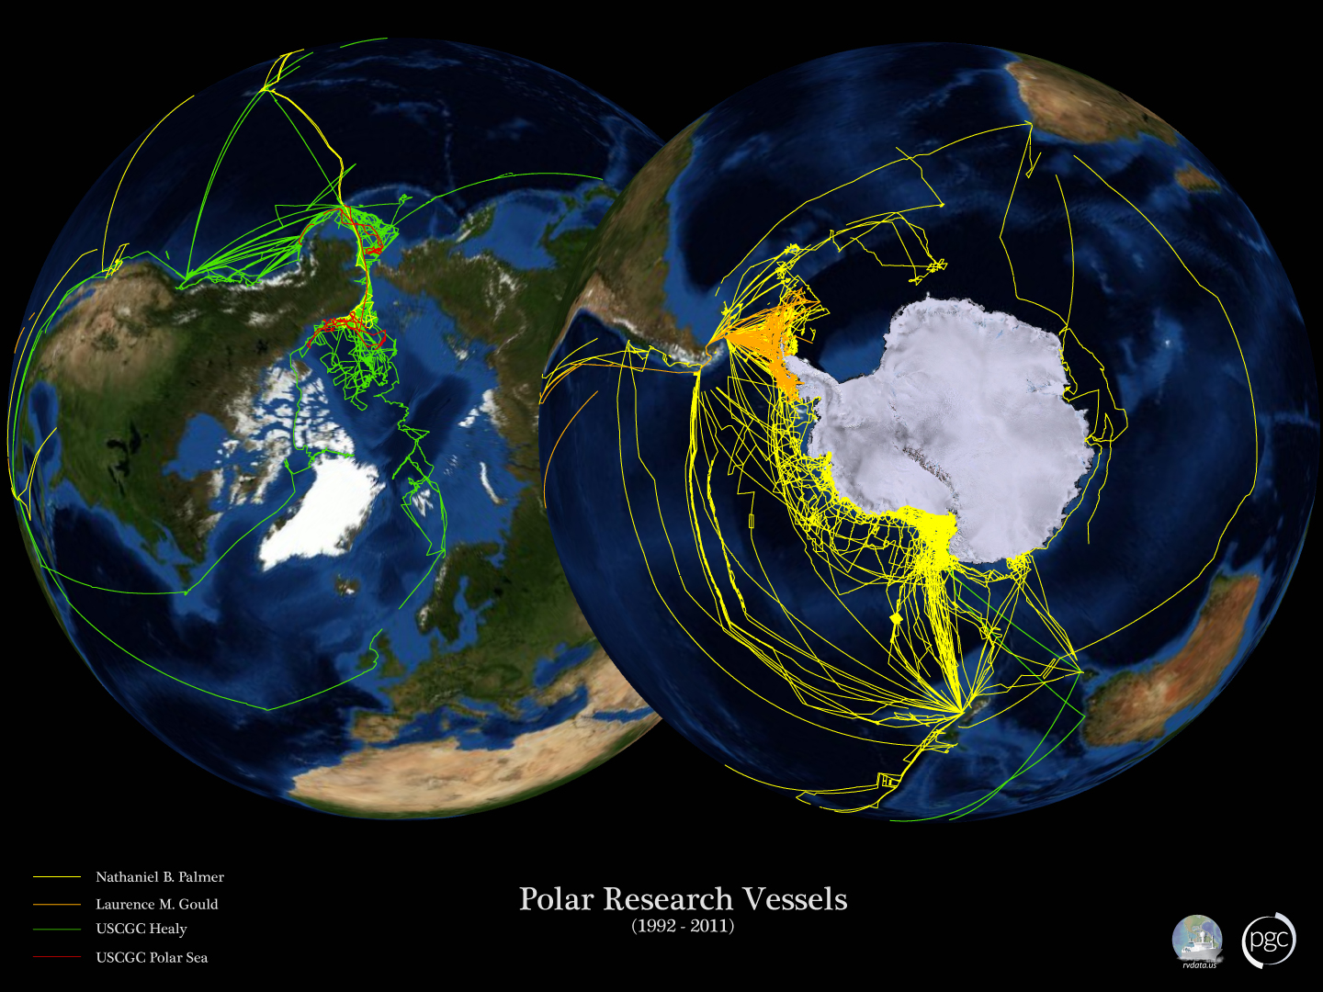

Slide 31
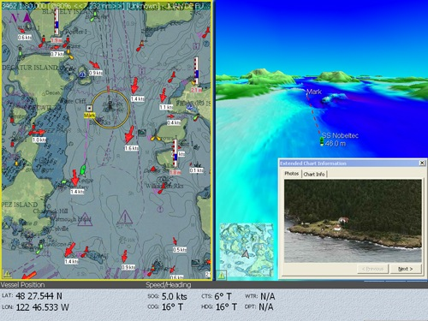
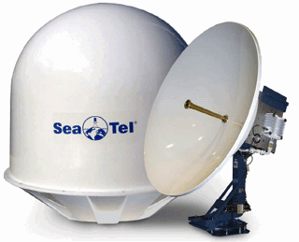
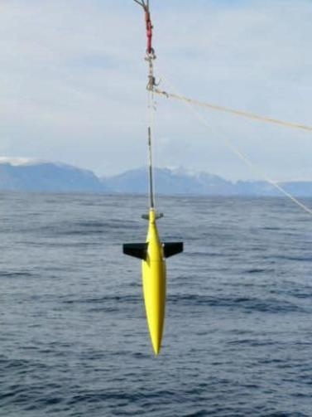
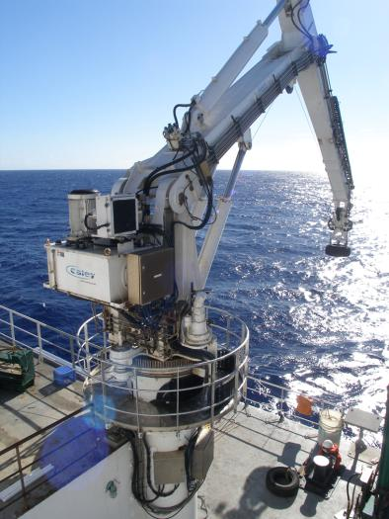
Research Vessels
Future direction of ocean capabilities
  Internet
  Bathymetry
  Glider/AUV Support & Handling Systems

Slide 32
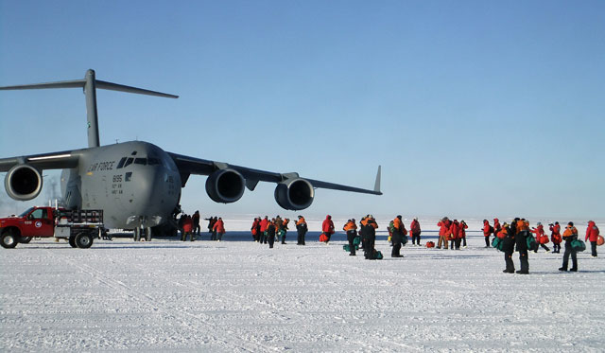
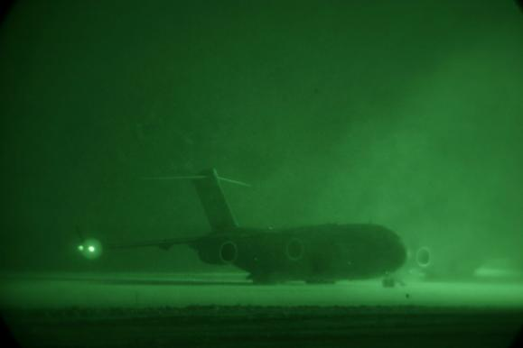
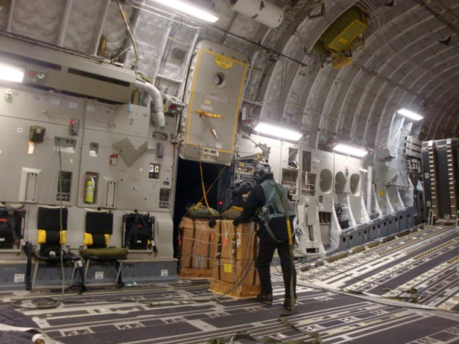
C-17 Airlift

Slide 33
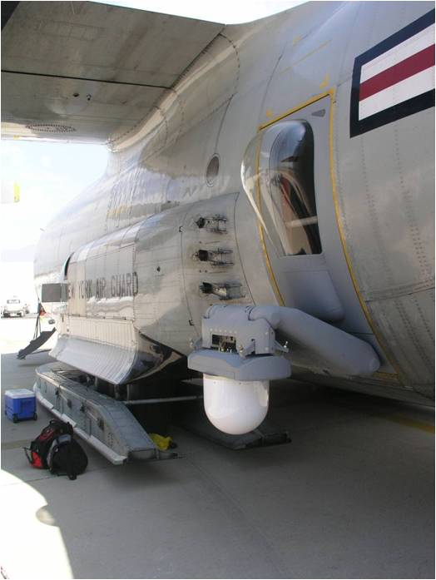
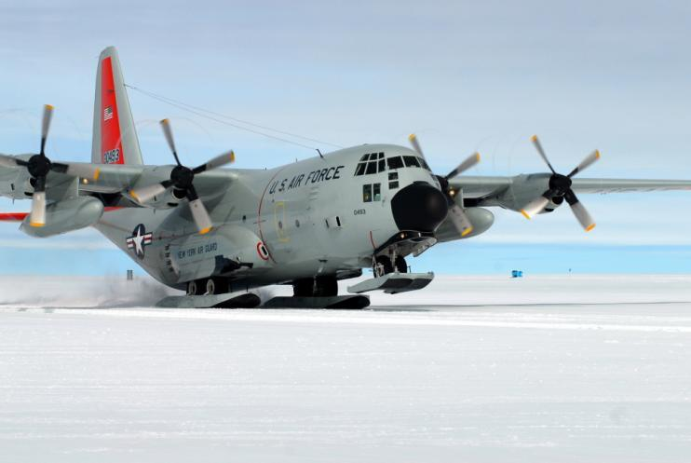
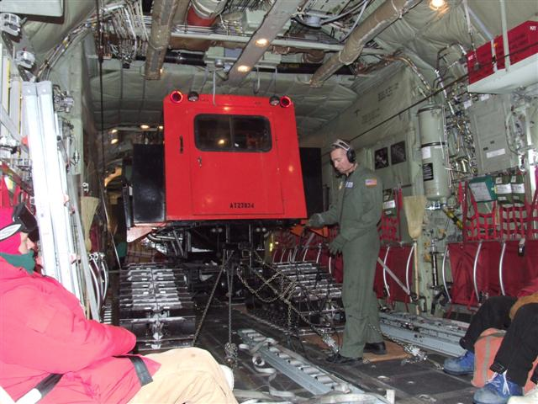
LC-130 Operations

Slide 34
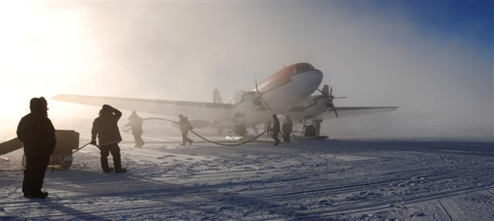
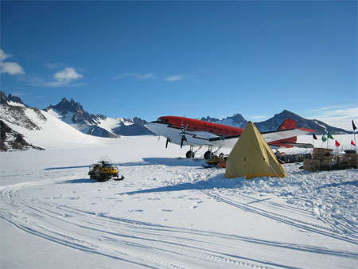
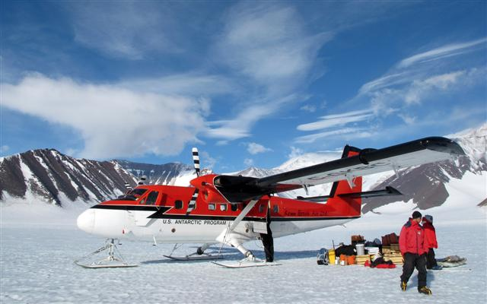
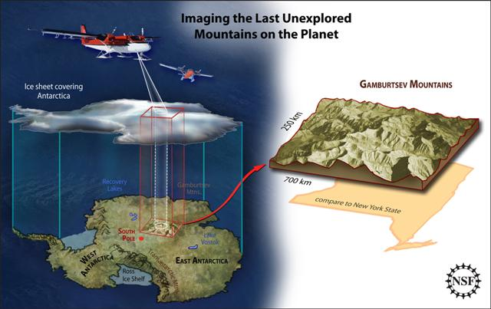
Basler & Twin Otter Aircraft

Slide 35
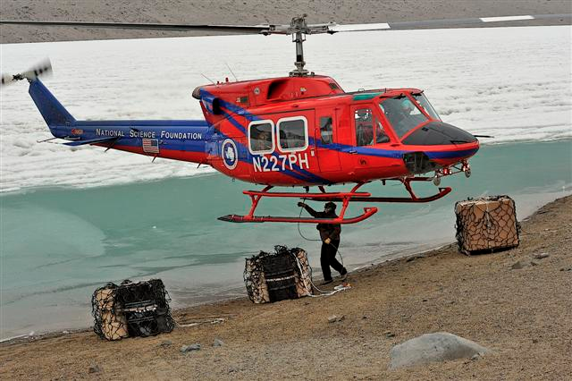
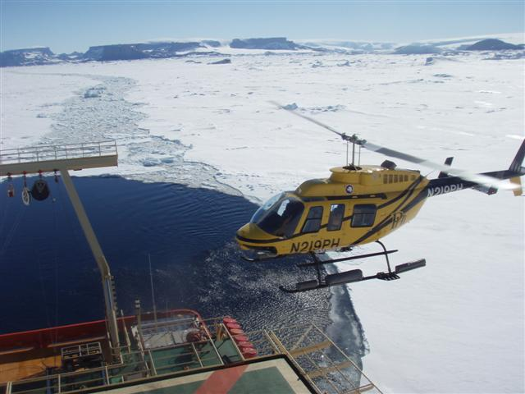
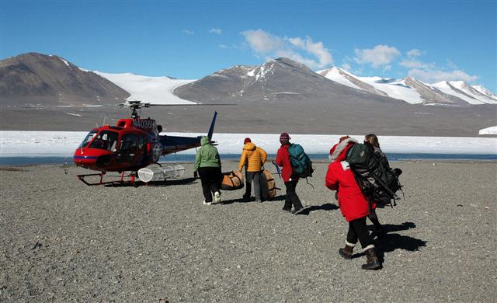
Helicopter Support

Slide 36



Overland Traverse

