Slide 1
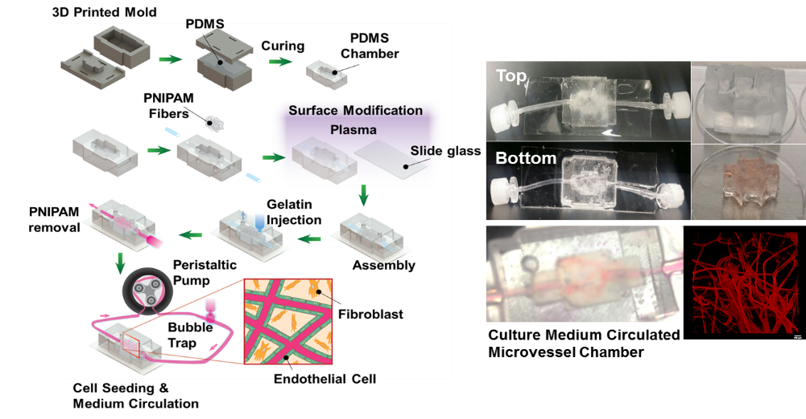
Engineering a Pro-Vasculogenic Capillary Network Regulating Host Responses
DMR 1506717
Leon M. Bellan, Vanderbilt University
To keep cells alive in thick engineered tissue, an artificial vascular network of channels is needed to provide interior cells with the gases and nutrients they require. We are fabricating capillary-like 3D microchannel networks in cell-laden gels using sacrificial microfiber templates. We make these templates out of a thermoresponsive polymer, PNIPAM, which dissolves in water below 32ºC but not in warm water. The PNIPAM microfibers are formed by high speed rotary spinning of PNIPAM/methanol solution in a fashion similar to a cotton candy machine. These microfibrous networks are embedded in warm gelatin solution (37ºC), and then “sacrificed” (washed away) by cooling the gelled matrix to room temperature, leaving behind an interconnected microchannel structure. This process is non-toxic to cells and achieves capillary-sized channels difficult to achieve using other approaches. We have demonstrated that these channels are critical to maintain cell viability deep within the gel. To demonstrate this concept in a co-culture of two cell varieties, we are currently generating stable endothelial linings on the microchannel walls, inside a gelatin gel embedded with fibroblasts.
Illustration of the sacrificial microfiber technique for generating microchannels in cell-laden gelatin hydrogels
Fibroblast (Red) and endothelial cell (Green) co-culture system in tissue-scale
microfluidic gelatin hydrogel (scale bar = 200 um)
Notes:
Cells need to be roughly a hair’s thickness (a couple hundred microns) distance, or closer, from a blood vessel to get nutrients, oxygen, and dispose of waste products…if they are too far away they will die. Thus, to make a tissue scaffold that is of significant thickness, an artificial vasculature is needed. We are focused on fabricating artificial capillary beds, as the capillary is where this exchange of soluble compounds generally occurs. Because capillaries are so small and dense, traditional fabrication techniques are unable to produce appropriate structures. “Bottom-up” assembly of cells into lumen structures will work for thin scaffolds, but in a thick scaffold the cells will die before having the time to assemble the vasculature. Using thermoresponsive materials, we form fibrous networks that are translated into channel networks similar to capillary beds, and seed cells in both the gel and (for endothelial cells) on the channel walls.

Slide 2
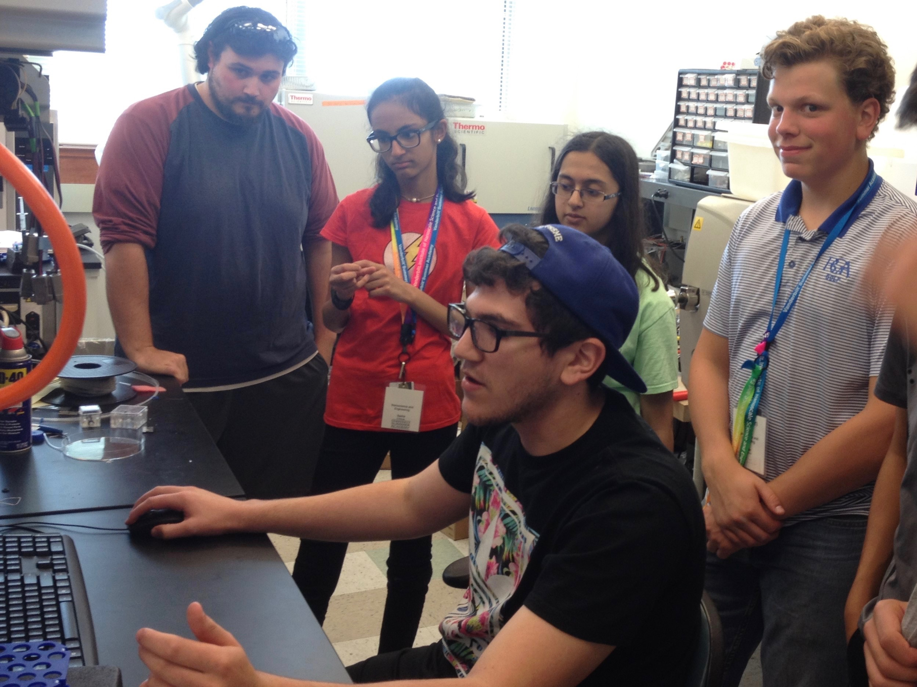
Engineering a Pro-Vasculogenic Capillary Network Regulating Host Responses
DMR 1506717
Leon M. Bellan, Vanderbilt University
The Bellan lab has hosted junior high and high school student groups, providing various hands-on demonstrations in which they get to experience various biomaterials phenomena.
Our work has been highlighted via NSF’s Science Nation and other media groups, increasing the public visibility of this work.
Additionally, Prof. Bellan has been developing an educational program for young students wherein they learn about the process of crosslinking polymers by making alginate “gummy worms”. Once fully developed, the curriculum will be hosted on the lab website.
Photos of visiting high school students participating in hands-on activities in Dr. Bellan’s lab, (top left) making “cotton candy” fibers to use as sacrificial templates to form artificial capillaries, (top right) exploring calcium crosslinking of alginate, gels and (bottom left) learning about 3D printing using biomaterials.

