Slide 1
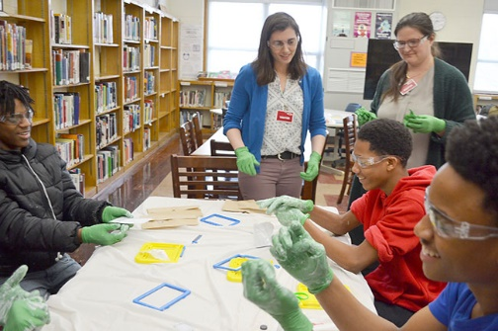
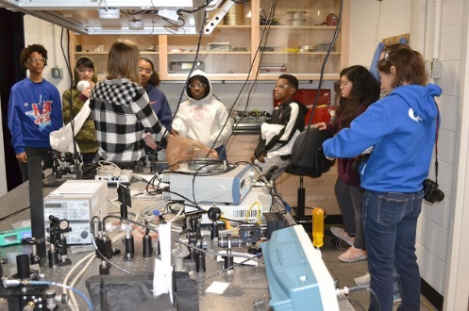
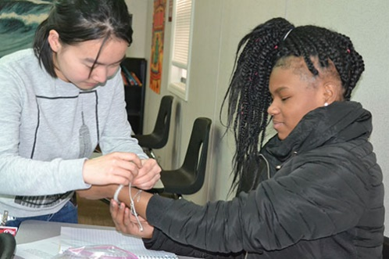
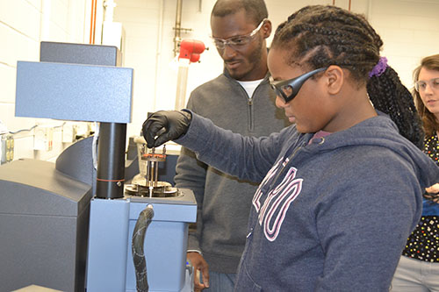
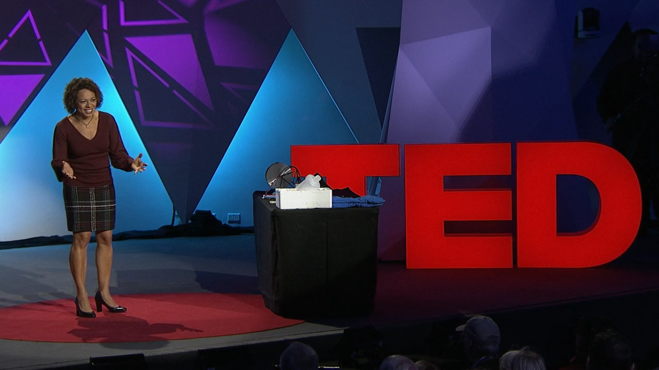
Musical Magnetism: Engaging More Middle School Students in Materials Science
DMR 1720633
2020
Nadya Mason, University of Illinois at Urbana-Champaign
The Illinois MRSEC ran their 8-week program “Musical Magnetism” for the second year. The program engages middle school students in materials science demos as they create song lyrics with a science theme. This year the program expanded to another grade, allowing participation by 50 7th and 8th graders at Franklin STEAM Academy.
An expanded number of hands-on activities increased engagement among students on topics related to materials science and magnetism. MRSEC Faculty and postdocs led lessons, while graduate students assisted throughout the program. Students and teachers from Franklin visited the MRSEC and Materials Research Lab over two days, where they used materials analysis tools, such as scanning electron and transmission microscopes, suited up for cleanroom tours, and participated in other activities that engaged them in research technologies. The students created and recorded songs and music videos with science themes.
An activity from this program was used as an illustration in Mason’s TED Talk, released in April 2020, on the theme of sparking scientific curiosity.
a)
b)
c)
d)
e)
f)
Fig. 1: a) Pena Martin assists a group of 8th graders as they take apart magnadoodles; b) A group of 7th graders and a teacher get a tour the Lorenz lab by Oolman during field trip to MRL; c) MRSEC grad student Wu helps a student with an optical material activity; d) An 8th grader uses a tool at MRL to study mechanical properties. Photos by B. Innes. e) and f) screenshots from Mason’s TED Talk, released in April 2020.
Read more: “Physics' Lorenz Shines a Light on Invisible Light “ (1/21/20), https://www.istem.illinois.edu/news/imrsec.musical.magnetism20.html
“Musical Magnetism’s Destroy-A-Toy Activity!” (2/13/20) https://www.istem.illinois.edu/news/imrsec.musical.magnetism.destroy-a-toy.html
“Franklin Steam Academy Students Experience Cutting-Edge Science at MRL” (2/27/20) https://www.istem.illinois.edu/news/franklin.MRL.visit.2020.html
Nadya Mason’s TED Talk: https://www.ted.com/talks/nadya_mason_how_to_spark_your_curiosity_scientifically

