Slide 1
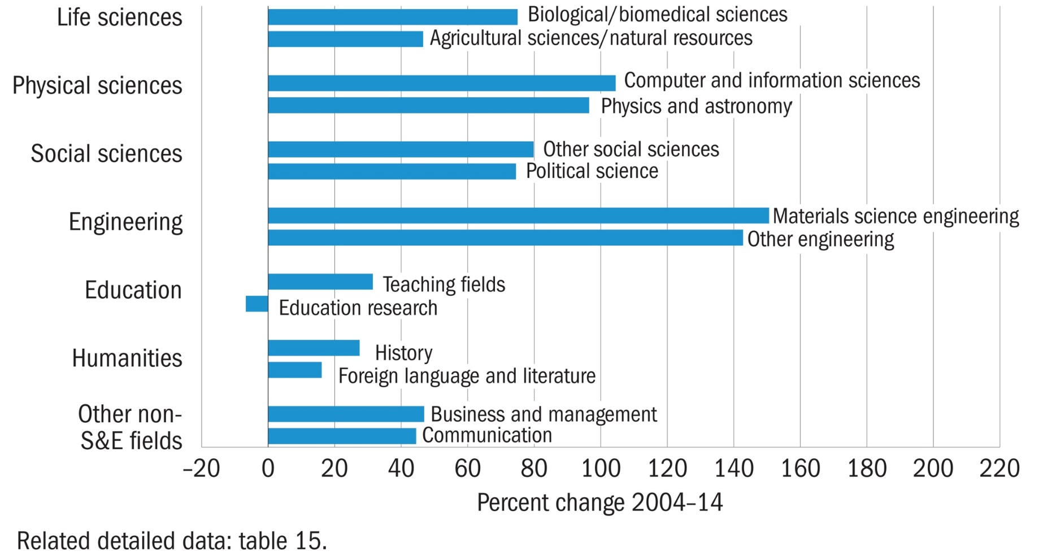
Top fields of study for female doctorate recipients, by broad field and select subfield: 2004–14

